Slide 1
Peer and Stakeholder Product Validation Review (PSPVR) for the
Full Validation Maturity of GOES-18 ABI L1b Products
GOES-R Calibration Working Group
With assistance from many
1 September 2023

Slide 2
Background
S/C | Launch | Beta | Provisional | Operational | Station | Full Validation
GOES-16 | 19 Nov 2016 | 28 Feb 2017 | 01 Jun 2017 | 18 Dec 2017 | East | 01 Jun 2018
GOES-17 | 01 Mar 2018 | 27 Aug 2018 | 28 Nov 2018 | 12 Feb 2019 | West | 19 Feb 2020
GOES-18 | 01 Mar 2022 | 11 May 2023 | 28 Jul 2022 | 04 Jan 2023 | West | 01 Sep 2023
GOES-18 is the 3rd in the GOES-R series.
  GOES-16 overcame a number of difficulties as the first one in the series.
  GOES-17 suffered from the Loop Heat Pipe malfunction.
  GOES-18 has been mostly normal with only a few exceptions.
The Full Validation PSPVR is the final scheduled review of ABI L1b products.

Slide 3
Definitions
The Program defines three levels of maturity for the GOES-18 ABI L1b products:
  Beta: the product is minimally validated and may still contain significant errors; based on product quick looks using the initial calibration parameters.
  Provisional: product performance has been demonstrated through a select number of independent measurements and periods. The analysis is sufficient to communicate product performance to end users, and the product is ready for operational use.
  Full: product performance has been demonstrated over a large and wide range of representative conditions, with comprehensive documentation of product performance, including known anomalies and their remediation strategies. The product is operational.
The Program defines two types of post launch tests:
  Post-Launch Test (PLT): Engineering-focused data collection and analyses designed to verify ABI instrument performance.
  Post-Launch Product Tests (PLPT): Science-focused data collection and analyses designed to validate ABI L1b product quality. 15 of these will be briefed for this review.

Slide 4
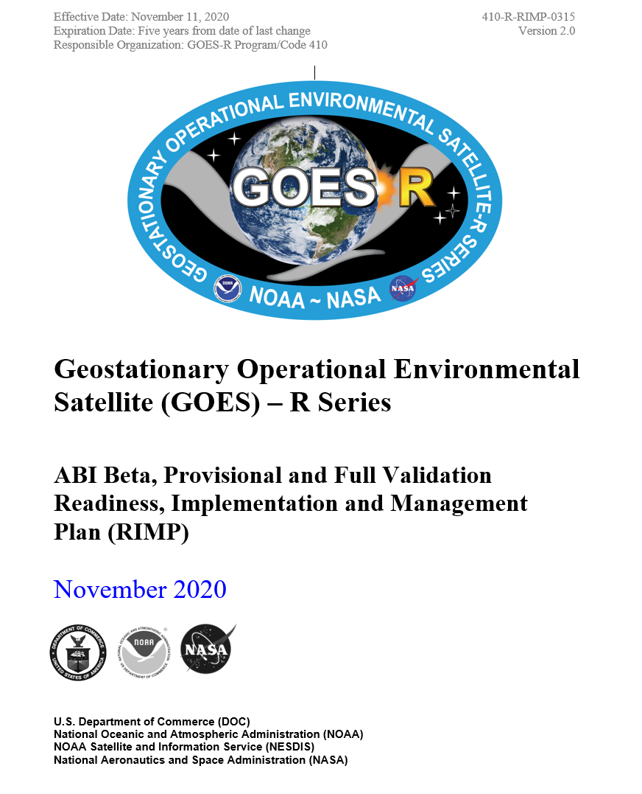
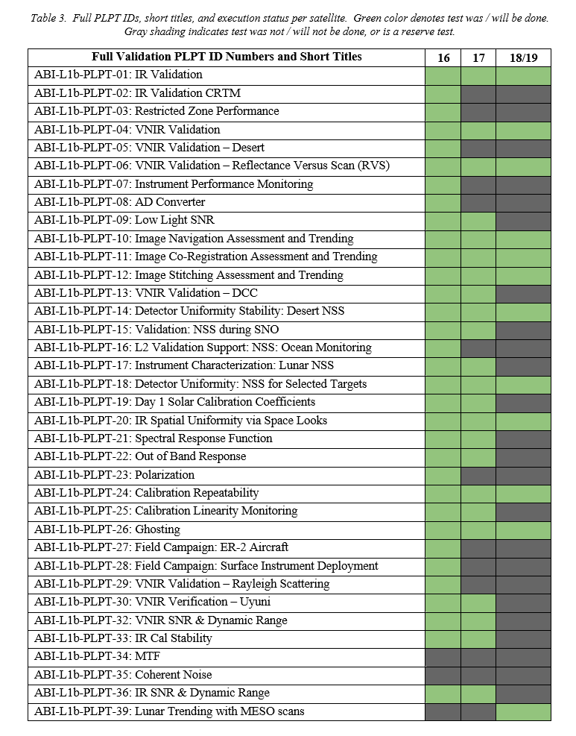
Scope – Required PLPT
PLPT-09: Added back with new methodology after the RIMP was published.
PLPT-20: Split into PLPT-40 & PLPT-41 (below).
ABI-L1b-PLPT-40 Space Chasing
ABI-L1b-PLPT-41 Space NSS

Slide 5
Organization
Key Performance:
  Briefed at the Provisional PSPVR with update for seasonality and stability
  “… over a large and wide range of representative conditions”
Issues:
  Status of issues identified at the Provisional PSPVR; and
  New issues thereafter.
Required PLPTs:
  “… comprehensive documentation”
  Brief the summary slide for each of the 15 tests.
  Slides with further details (40 – 141) can be presented at request.

Slide 6
Radiometric calibration – vnir
Key Performance

Slide 7
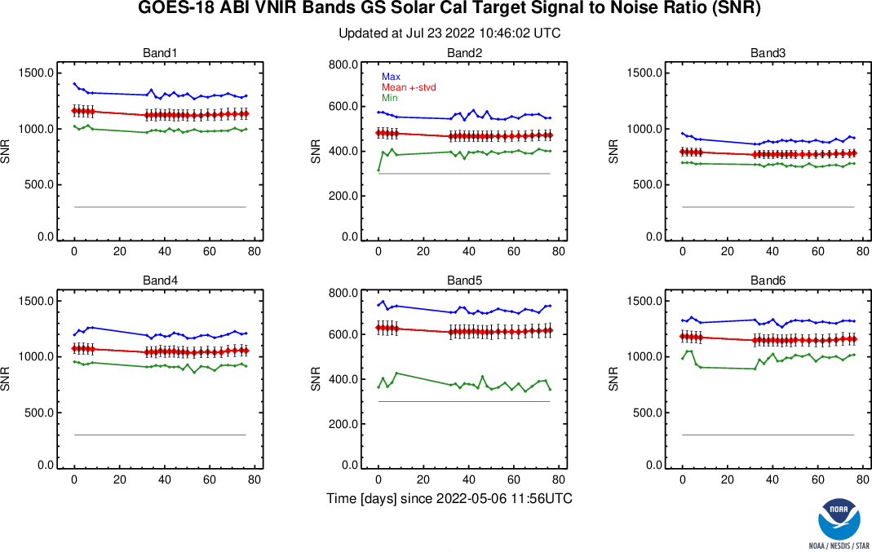
G18 VNIR SNR at Provisional
Maximum, Average ± stdv, minimum, and the MRD for the six ABI VNIR channels.
The higher, the better.
The min (green) must be higher than the requirement (gray).
GOES-18 ABI VNIR channels SNR are substantially higher than required.
Channels 1, 4, and 6 are ~3 times better; Channels 3 and 5 are ~2 time better; and Channel 2 is ~1.5 times better.
The difference between pre- and post-drift is due in part to the update of E_{sun} and Q-LUT.

Slide 8
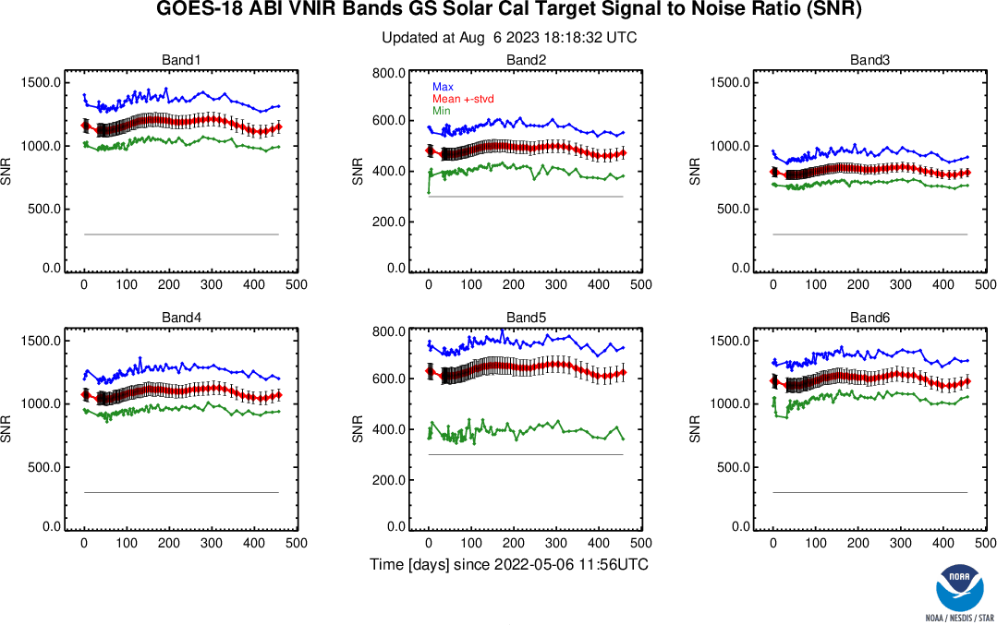
G18 VNIR SNR at Full Validation
Maximum, Average ± stdv, minimum, and the MRD for the six ABI VNIR channels.
The higher, the better.
The min (green) must be higher than the requirement (gray).
The performance has been stable and remains excellent.

Slide 9
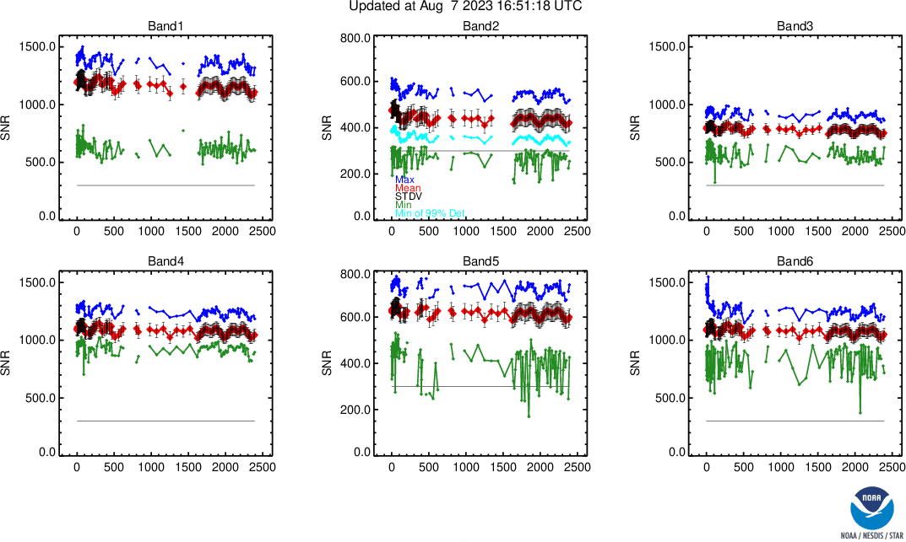
Recent G16 VNIR SNR
Maximum, Average ± stdv, minimum, and the MRD for the six ABI VNIR channels.
The higher, the better.
The min (green) must be higher than the requirement (gray).
GOES-18 is similar or better than GOES-16.

Slide 10
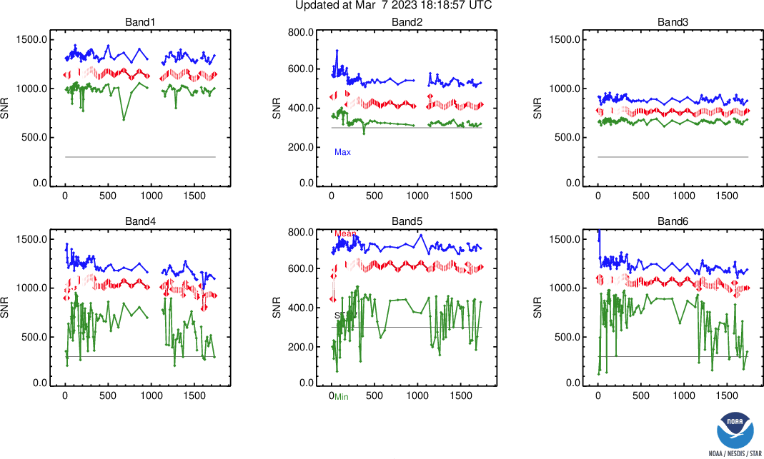
Recent G17 VNIR SNR
Maximum, Average ± stdv, minimum, and the MRD for the six ABI VNIR channels.
The higher, the better.
The min (green) must be higher than the requirement (gray).
GOES-18 is similar or better than GOES-17.

Slide 11
VNIR Channel SNR
The higher, the better.
G16 was waived to be higher than 300 for 99% of the detectors, and the rest 1% must be higher than 150. GOES-17/18 don’t need this waiver.
GOES-18 ABI VNIR SNR is better than GOES-16/17 ABI (except in one case).

Slide 12
VNIR Radiances Are Accurate
The closer to zero, the better.
Requirement is marked by the green lines.
GOES-18 ABI VNIR accuracy is comparable to GOES-16/17 and meet the requirement of 5%.
GOES-16/17 B02 were shown as corrected after Full Validation

Slide 13
Radiometric calibration – ir
Key Performance

Slide 14
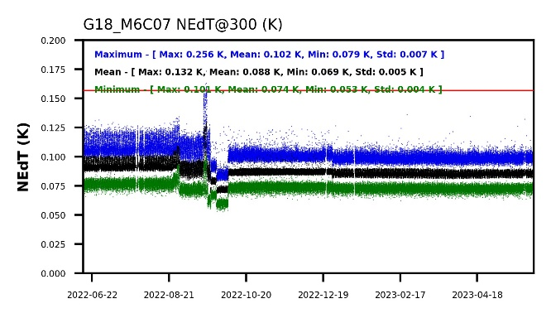
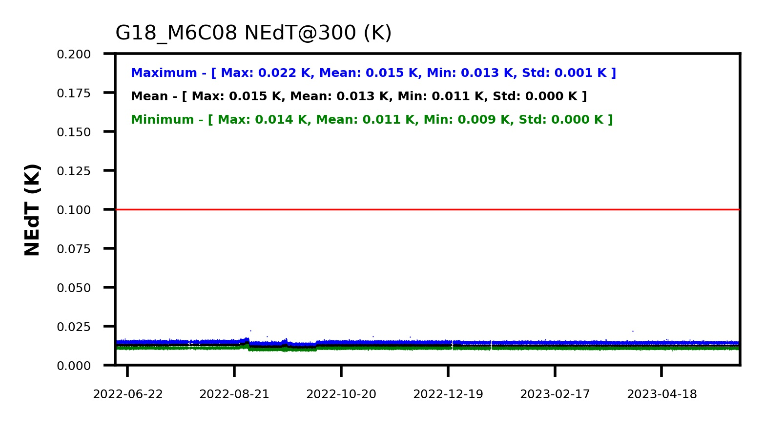
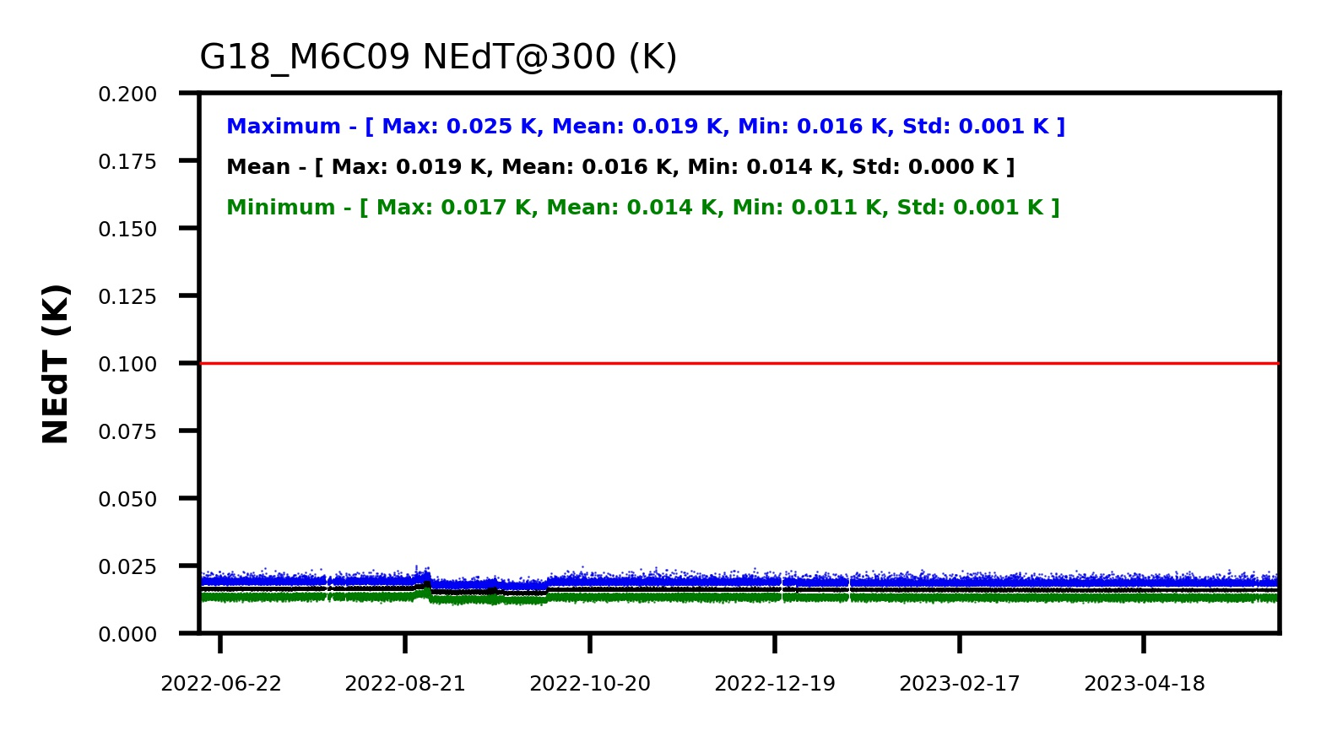
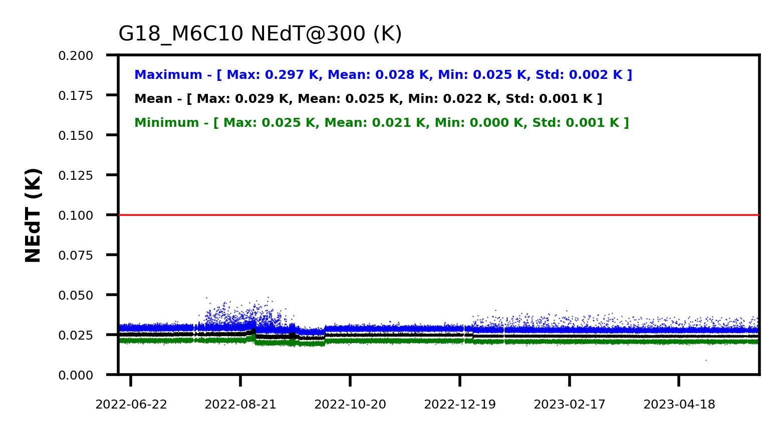
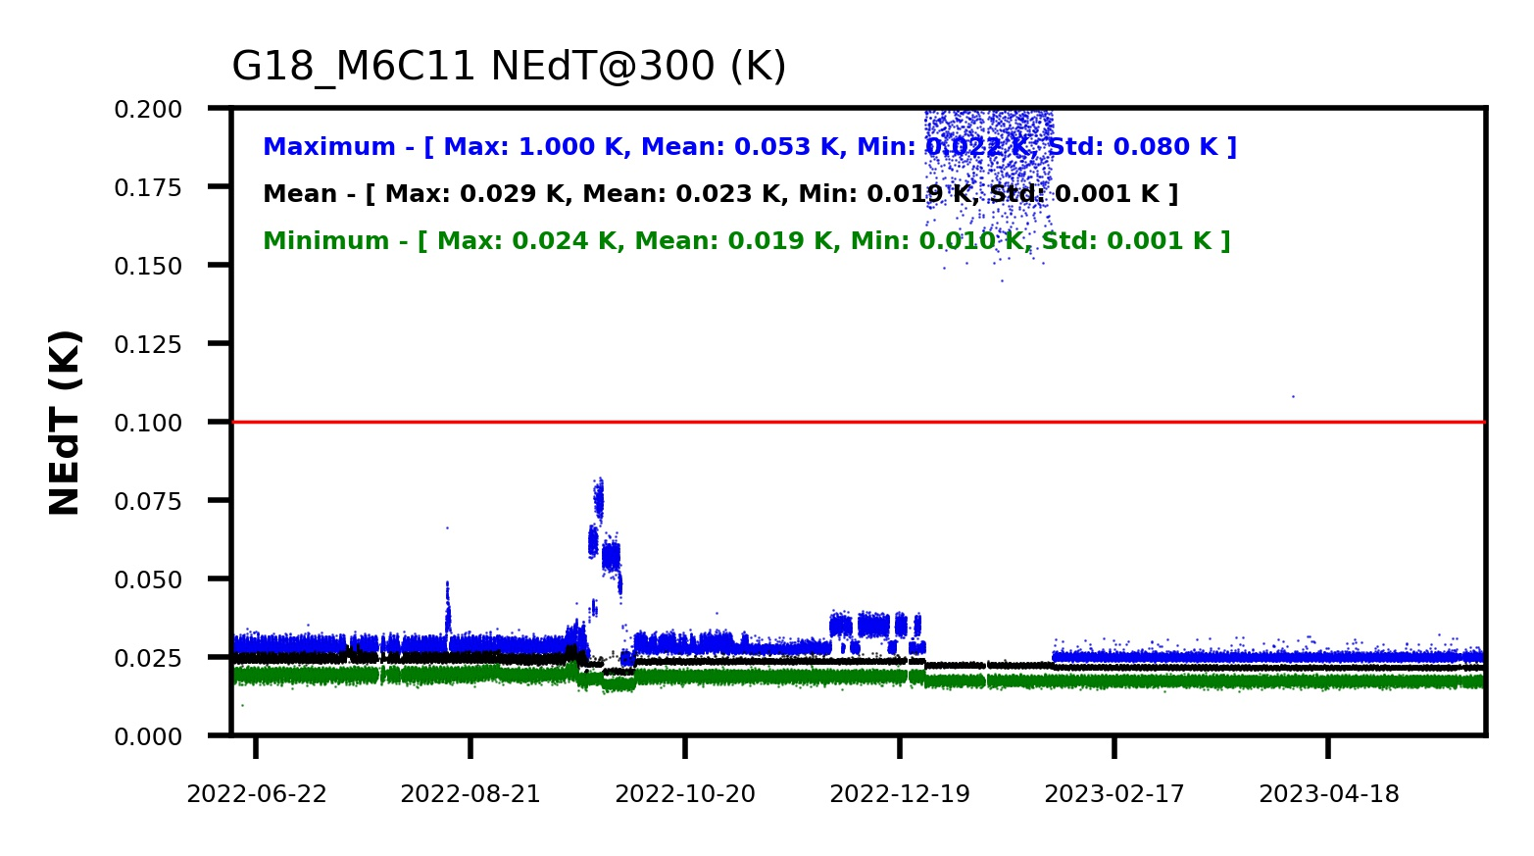
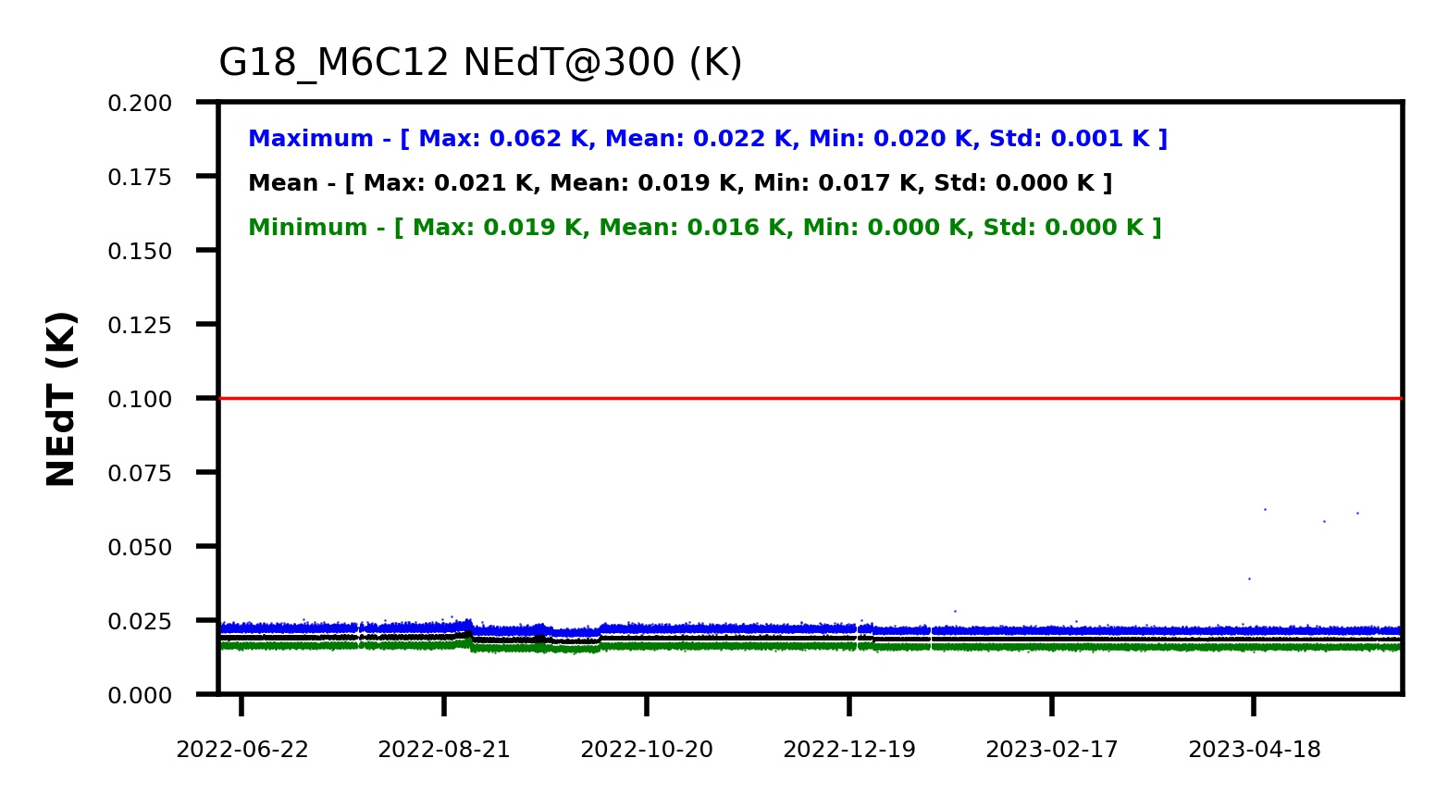
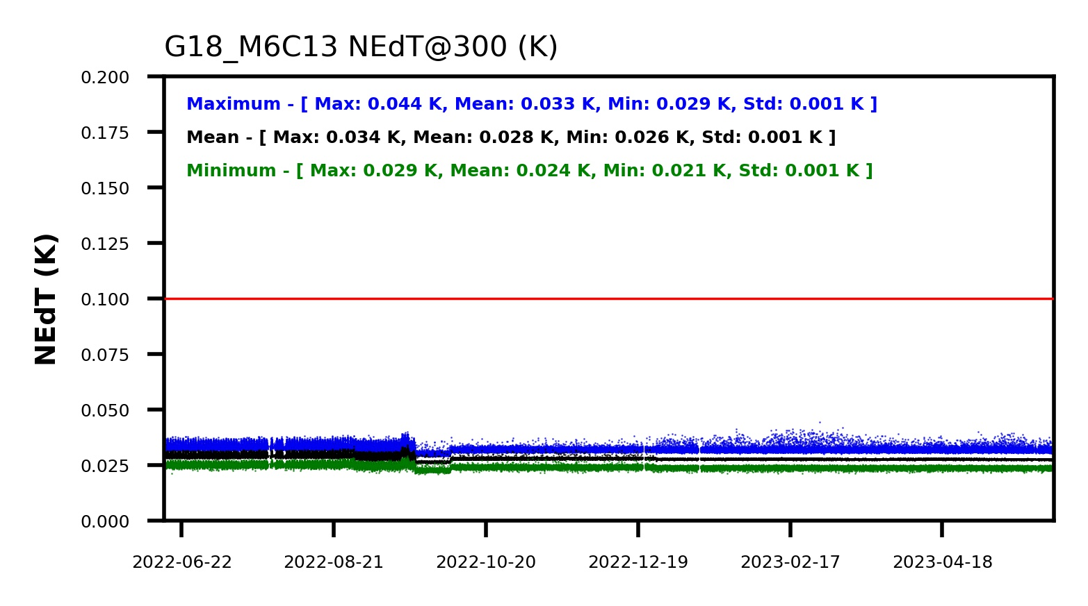
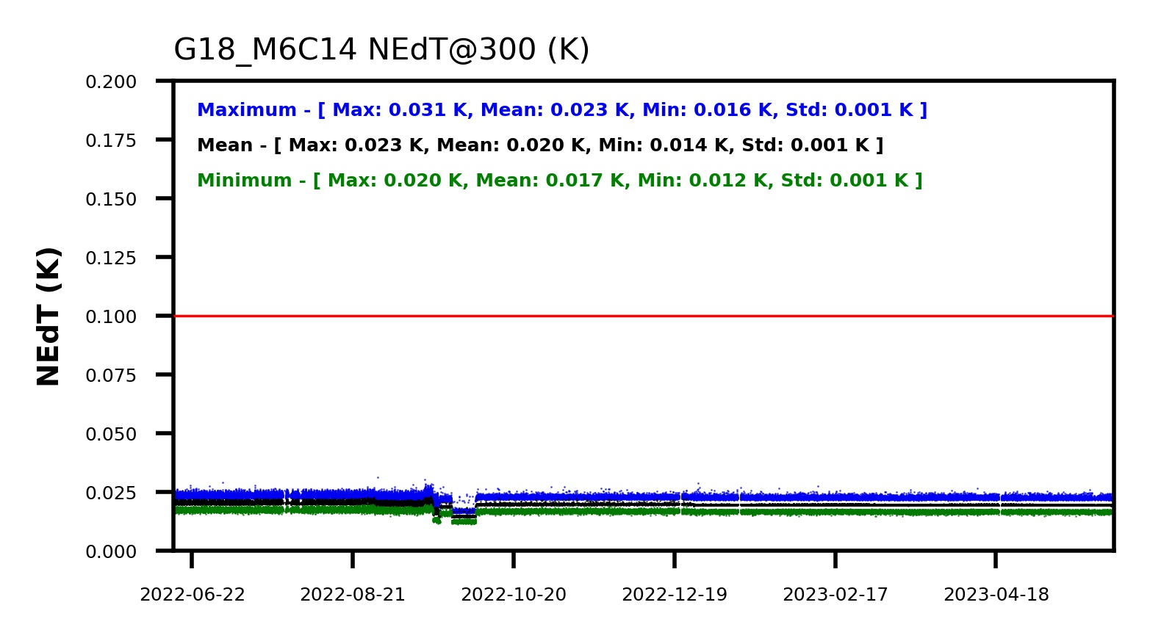
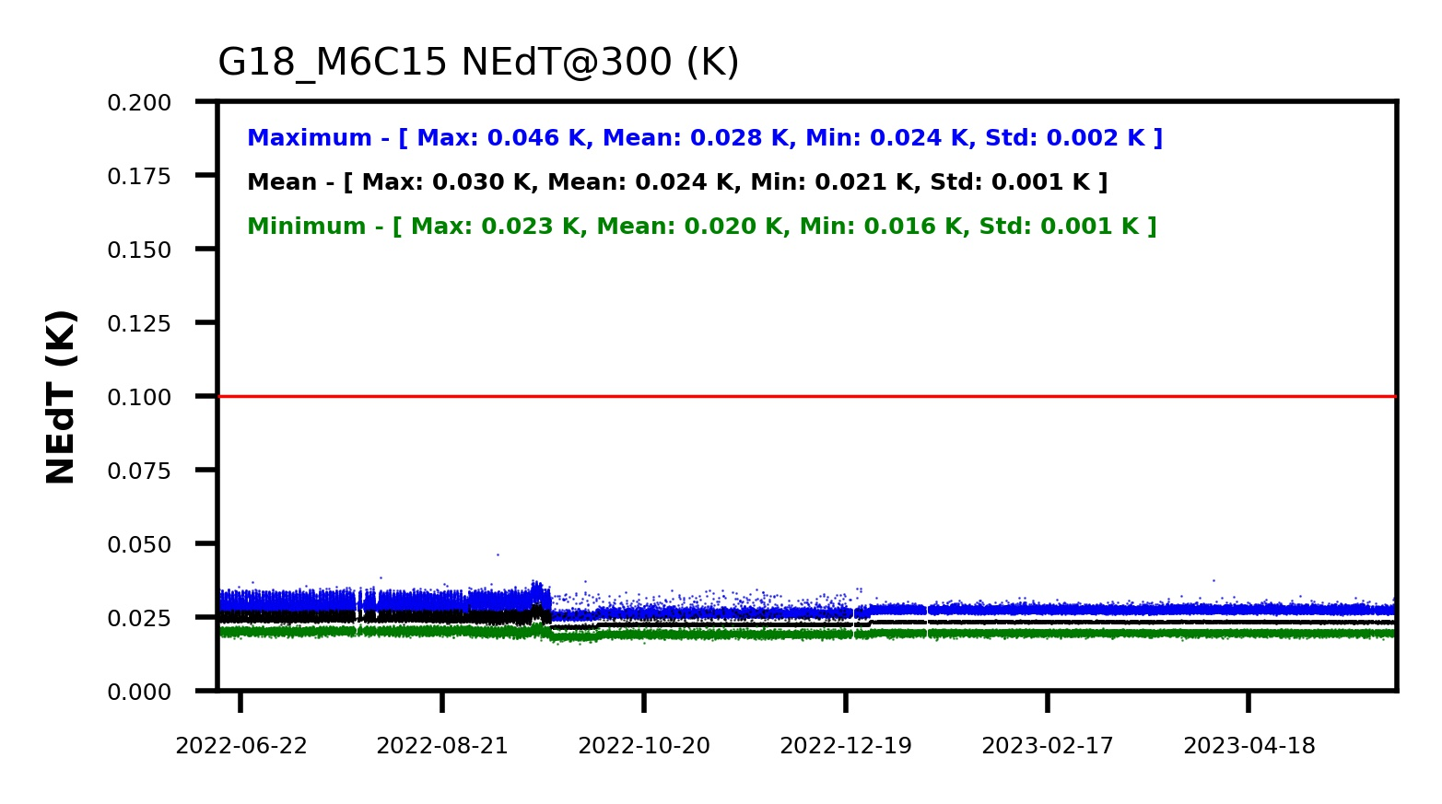
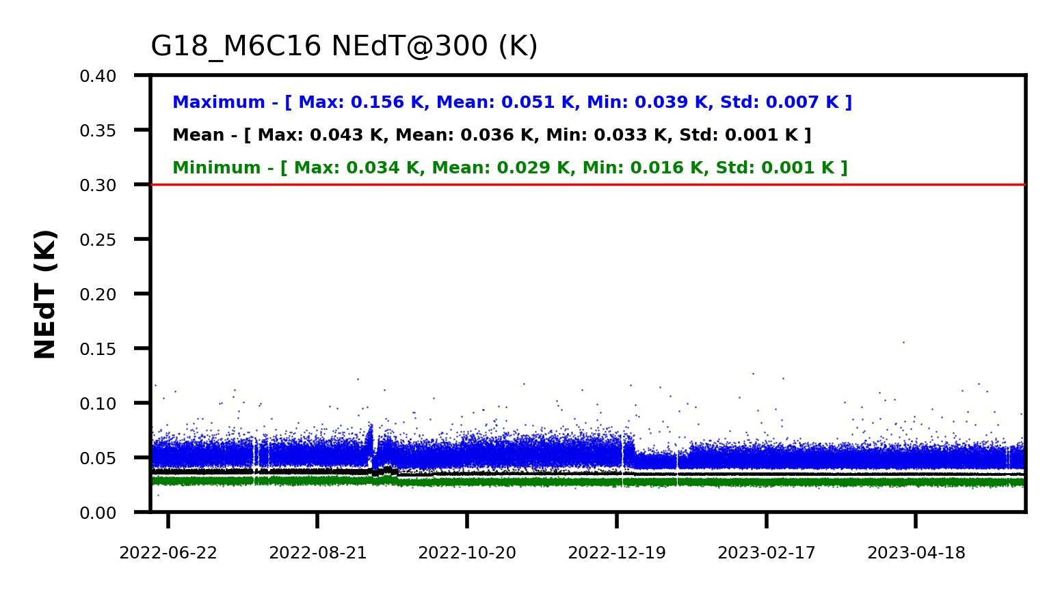
Noise is Low and Stable
One-year time series of min / mean / max detector noise for each channel.
Red line is detector noise requirement for B07 and pixel noise requirement for other channels.
Stable over time with large margins, except during BA testing and for one bad detector (B11) 12/26 – 1/30.

Slide 15
Noise Is Comparable with GOES-16
The lower, the better.
Not compared with GOES-17 because of the LHP anomaly.
All channels are better than MRD and, except for the 3.9 µm channel, better than GOES-16.
Required detector noise for B07 and pixel noise for other channels.

Slide 16
Noise Is Comparable with GOES-16
Channel | Requirement | GOES-16 | GOES-18
3.90 | 157 | 85 | 126
6.19 | 100 | 15 | 17
6.95 | 100 | 17 | 23
7.34 | 100 | 26 | 36
8.50 | 100 | 21 | 32
9.61 | 100 | 21 | 62
10.3 | 100 | 32 | 40
11.2 | 100 | 22 | 25
12.3 | 100 | 25 | 32
13.3 | 300 | 103 | 118
All channels are better than MRD and, except for the 3.9 µm channel, better than GOES-16.
Required detector noise for B07 and pixel noise for other channels.

Slide 17
IR Radiances Are Accurate (Low Bias)
The closer to zero, the better.
Requirement is marked by the green lines.
Comparable to or slightly better than GOES-16/17.
An order of magnitude better than MRD.

Slide 18
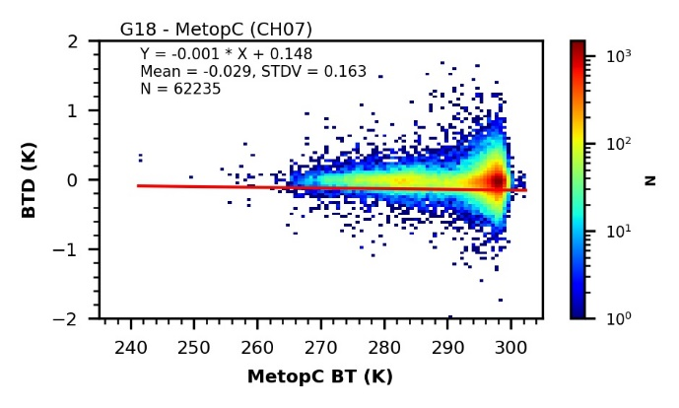
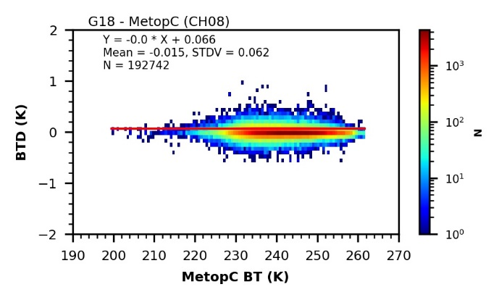
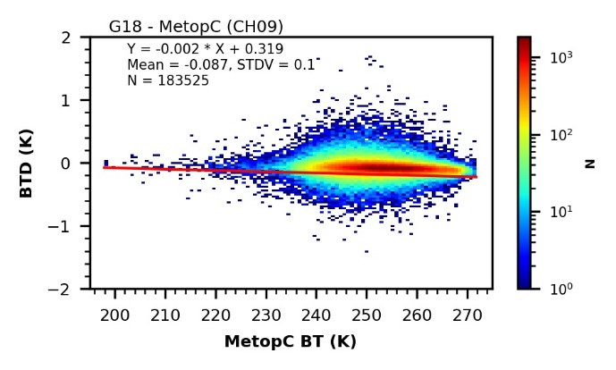
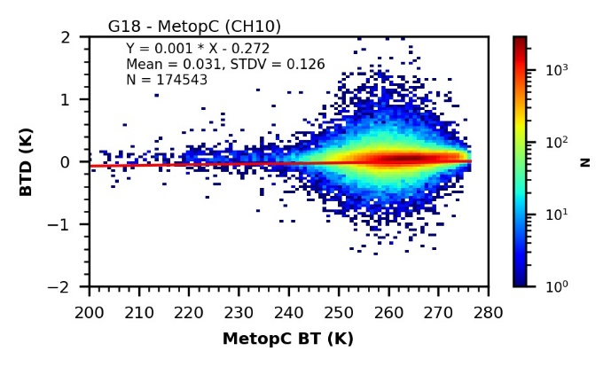
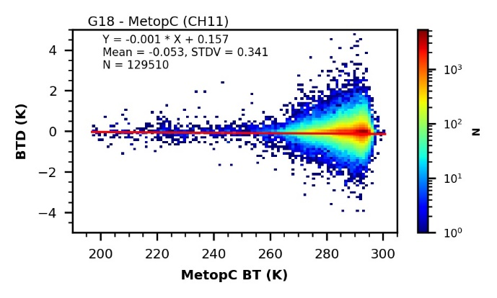
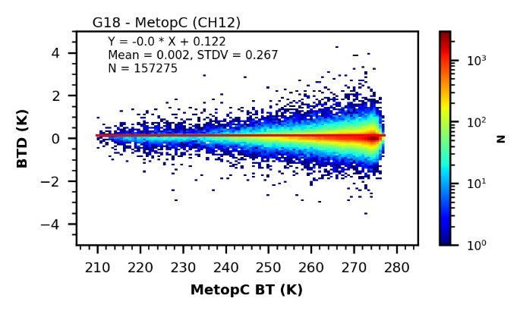
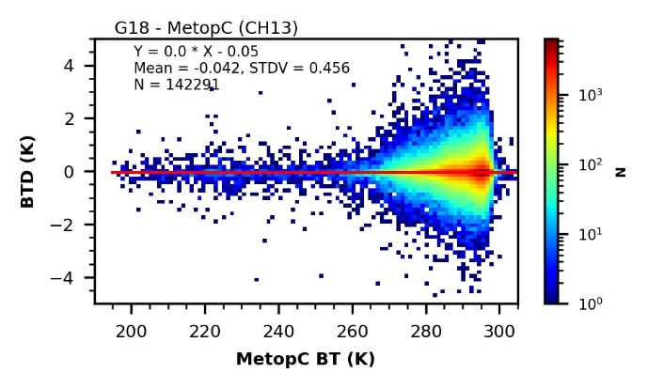
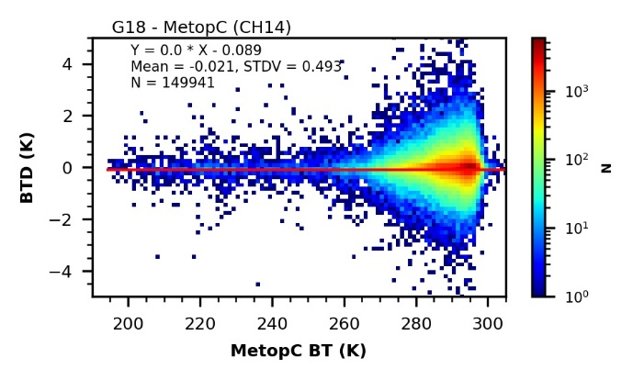
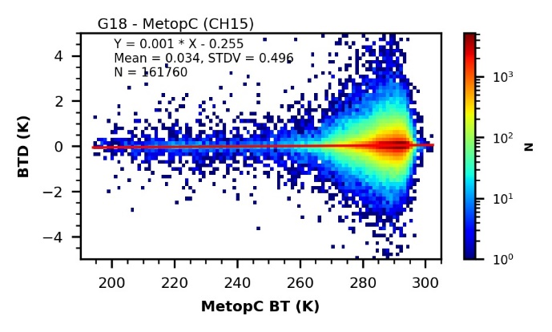
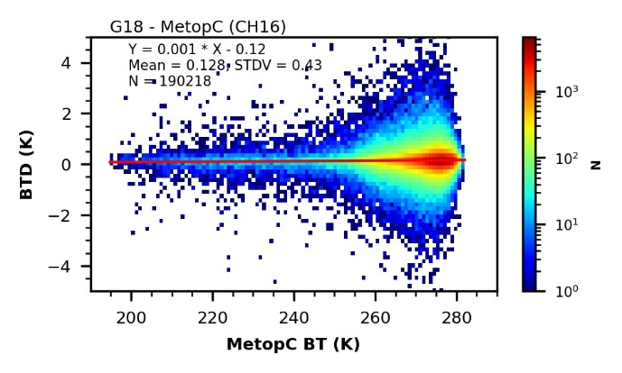
Independent of Scene Radiance
Density plot of bias as a function of scene radiance (brightness temperature) for the ten GOES-18 ABI IR channels.
No strong scene radiance dependent bias

Slide 19
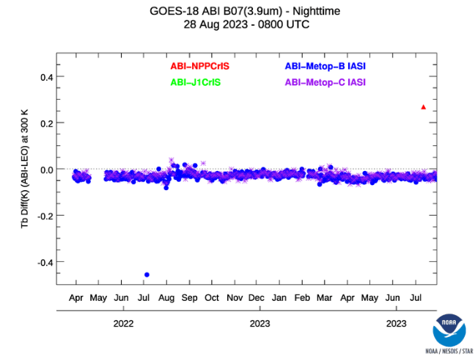
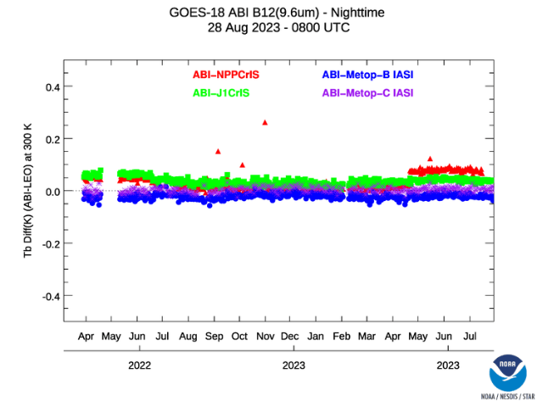
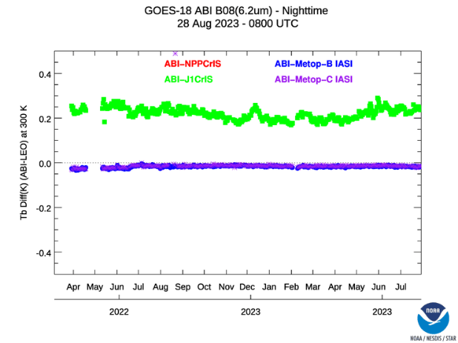
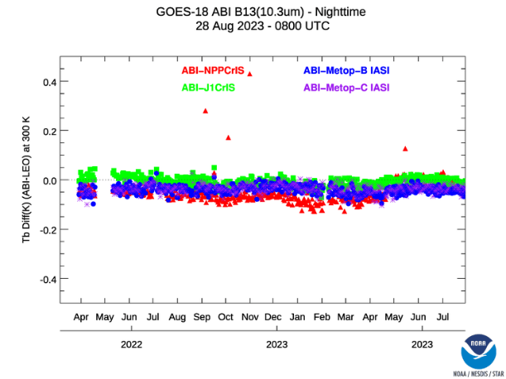
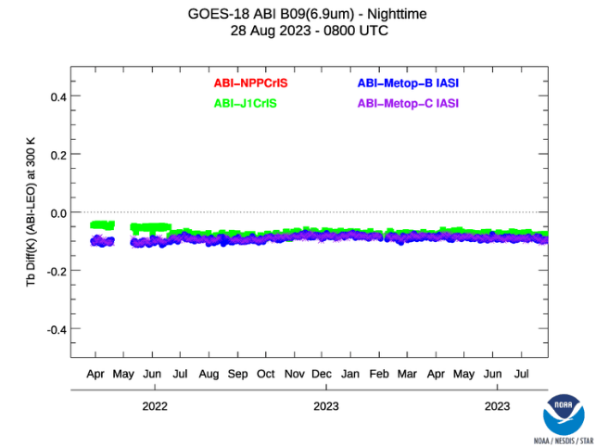
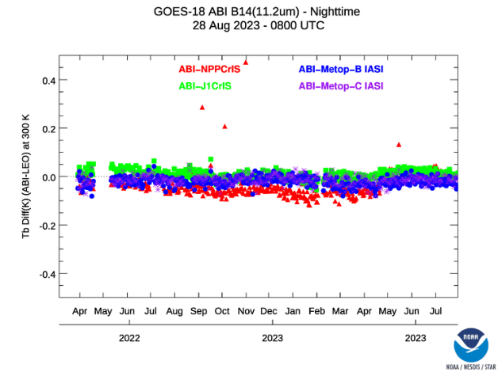
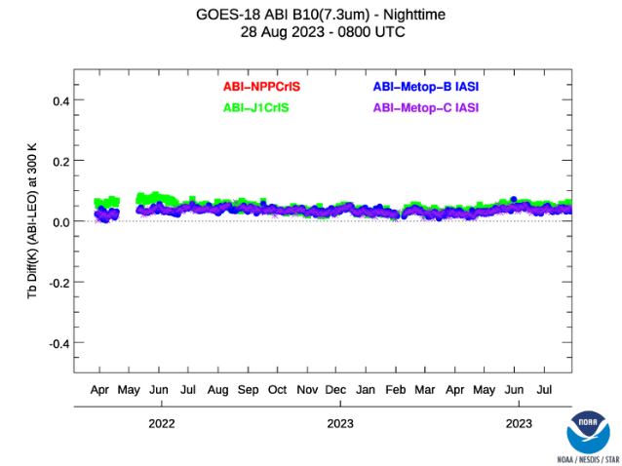
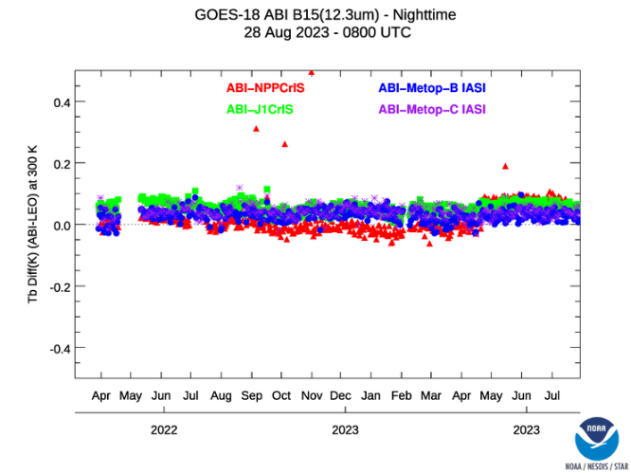
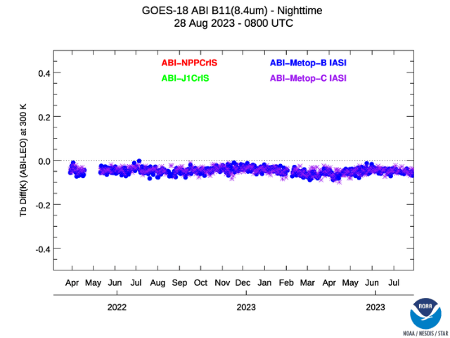
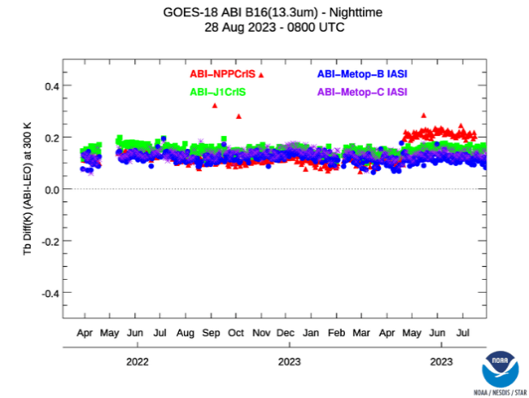
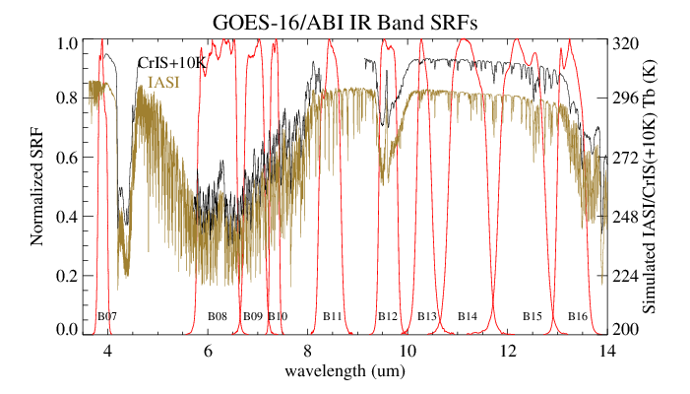
Stable in One Year
N20 SNPP anomaly
Stable bias compared with the reference instruments after the scan mirror (SM) update on 06/27/2022
CrIS partially covers ABI B08 & B11 SRF.
SM LUT update on 06/27/2022

Slide 20
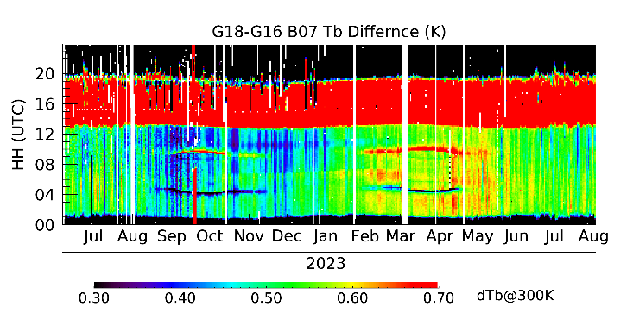
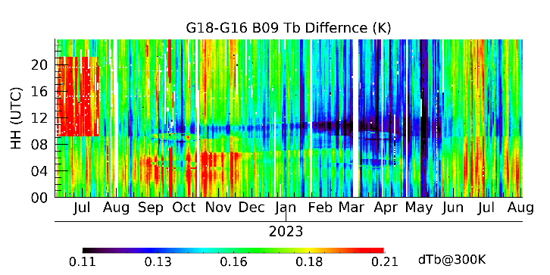
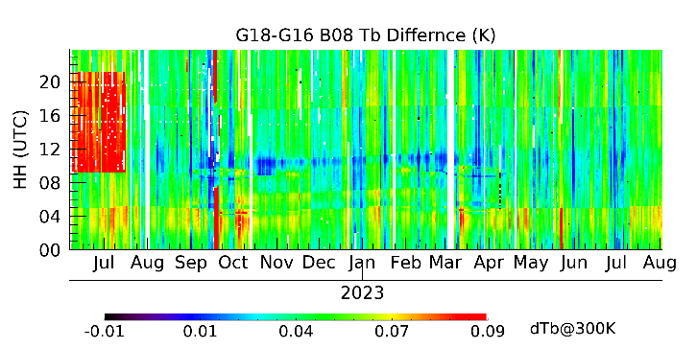
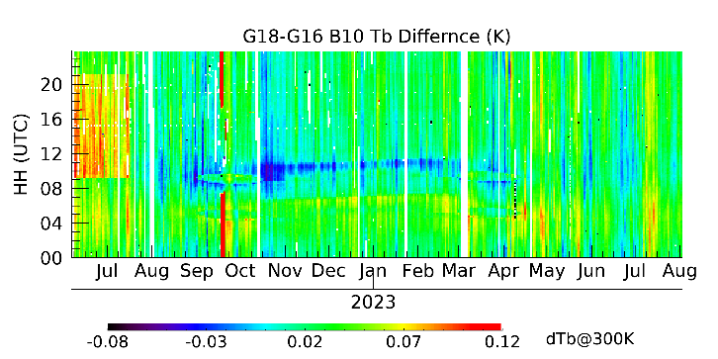
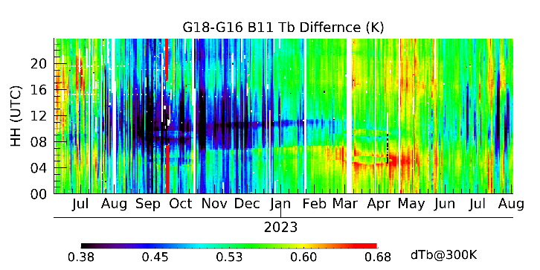
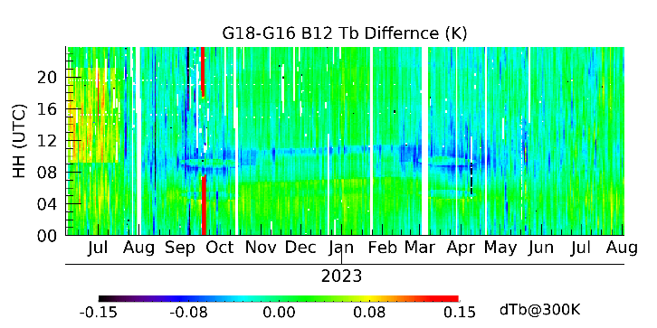
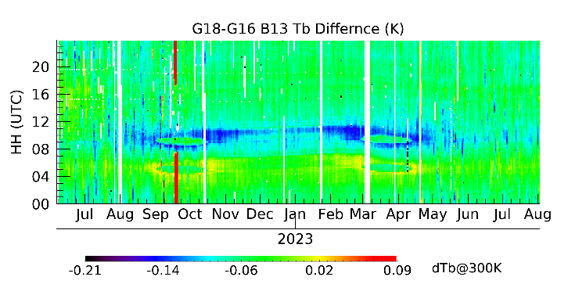
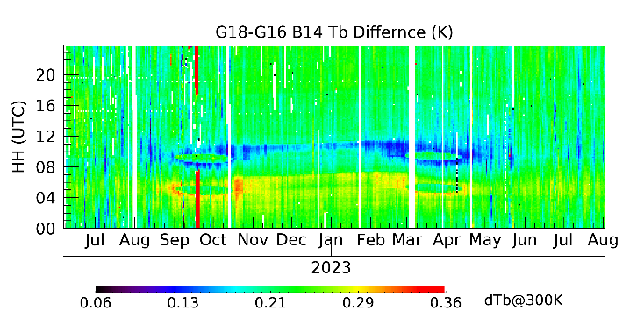
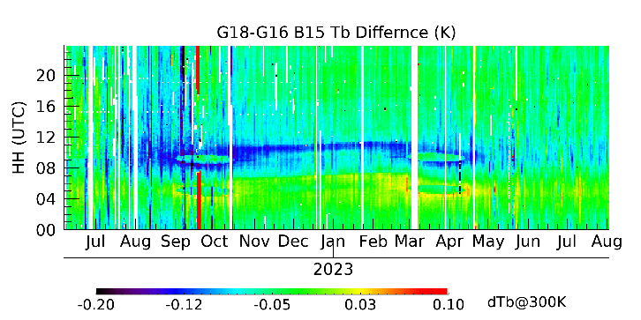
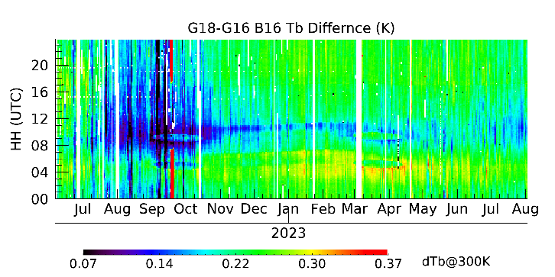
Independent of Orbit (Diurnal)
Daytime solar
Straylight around eclipse midnight
IR Scan mirror (SM) update on 06/27
Highly sensitive monitoring detect diurnal (and seasonal) variation of bias that is a fraction of 1 K @ 300 K (requirement).
IR midnight variation

Slide 21
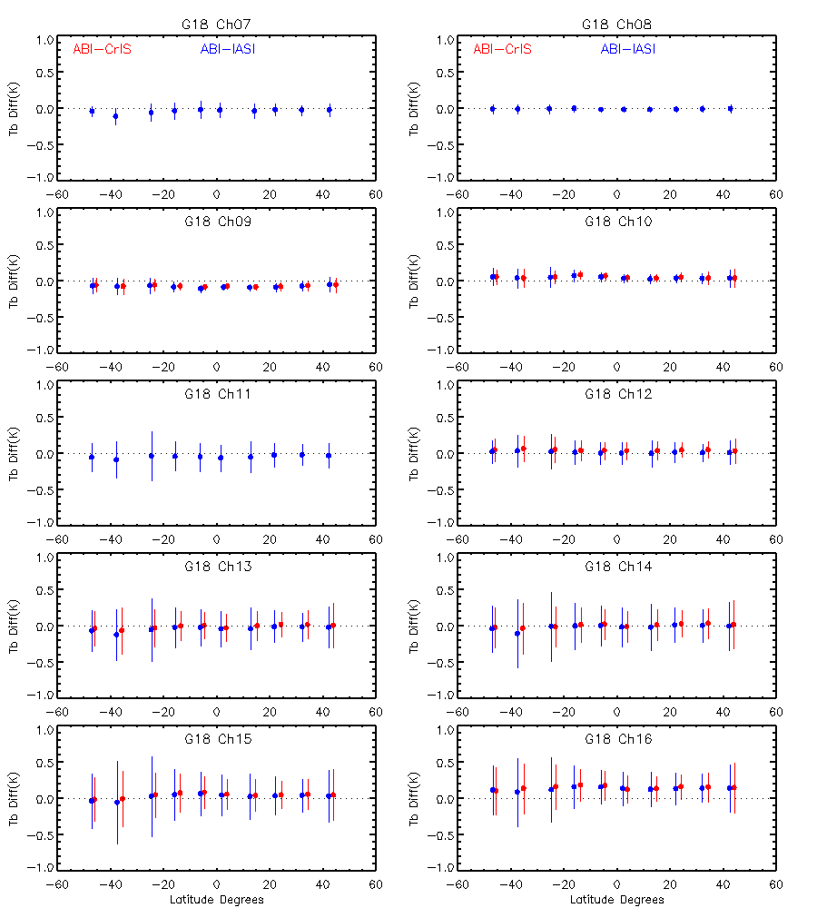
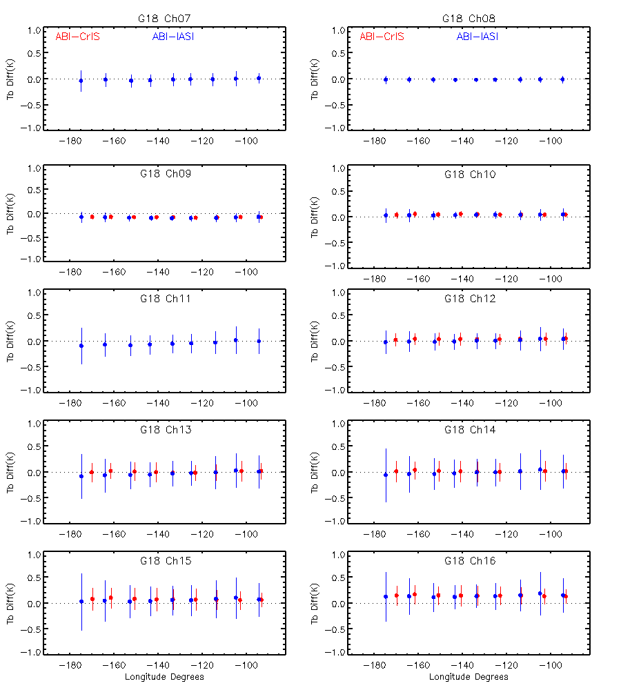
Independent of Scan Angles

Slide 22
image navigation and registration
Key Performance

Slide 23
Navigation (NAV) Error
The lower, the better.
GOES-18 is comparable to GOES-16/17 at Full Validation.
All are better than the requirements with ample margin.

Slide 24
Frame-to-Frame Registration (FFR) Error
The lower, the better.
Comparable to GOES-16/17 at their Full Validation. Better than MRD.

Slide 25
Within Frame Registration (WIFR) Error
The lower, the better.
Comparable to GOES-16/17 at their Full Validation. Better than MRD.

Slide 26
Channel-Channel Registration (CCR) Error
The lower, the better.
All meet the MRD. Comparable or better than GOES-16/17.

Slide 27
Review of issues

Slide 28
B05 Bias Now Meet the Requirement
The closer to zero, the better.
Requirement is marked by the green lines.
Provisional
B05 was exceeding the requirement but was not modified because of its large uncertainty at the time and is only 2.1% brighter than SNPP VIIRS. It is now within the requirement.
Full

Slide 29
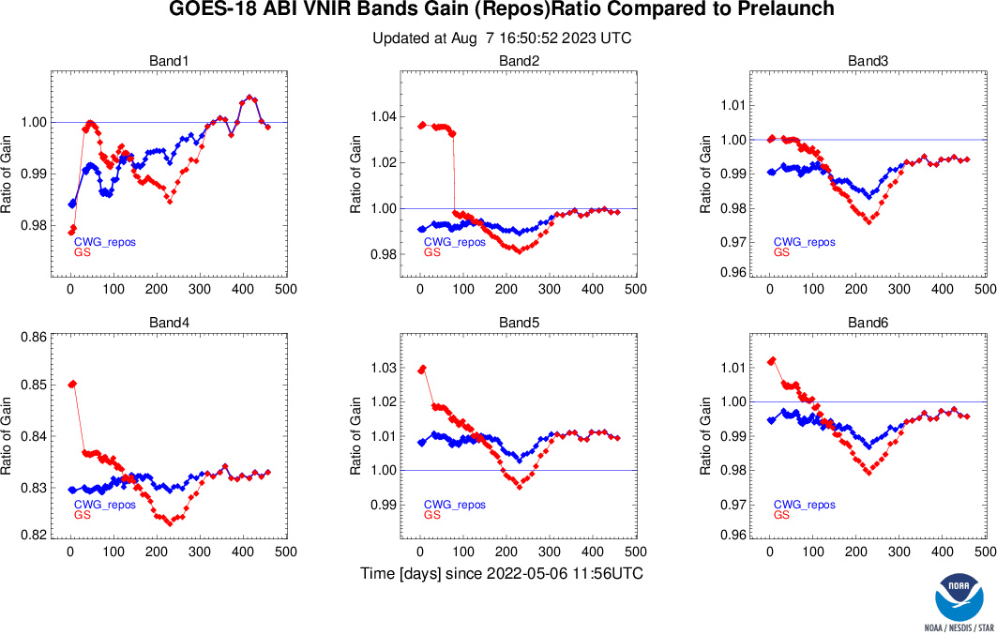
Unexpected Trend of Solar Channel Gains
At the time, this was suspected to be related to the residual beta angle dependence.
Later it was found that the SCT norm vector was incorrected.
This issue has been corrected, although beta angle correction is still on-going.

Slide 30


Barcode Artifact (BA)
Vertically oriented artifacts was found in GOES-18 B07 (3.9 µm) images shortly after GOES-18 was drifted to 136.8 W.
It has since been named “Barcode Artifact” (BA), a type of persistent noise with low intensity that tends to show in images over cold region, of channel- or time-difference, in animation, and especially the combination thereof.
BA has been absent in products not using Channel 7 or not focusing on cold scenes (e.g., fire).
BA was substantially reduced after Sep 22, 2022, and may have changed its characteristics more subtly after Dec 25, 2022.
GOES-18
GOES-17
D. Lindsey

Slide 31

Example of BA
9/17/2022
before the 9/22 diminishing
9/24/2022
after the 9/22 diminishing
E. Kline / W. Line
Animation of nighttime microphysics RGB that uses T_{b}(10.4 µm) – T_{b}(3.9 µm).
BA is most readily observed in products of channel difference animation.
Substantial reduction of BA after 22 Sep 2022 (around the equinox) for unknown cause.

Slide 32
How to Characterize BA
BA was discovered by visual inspection of earth viewing images.
As long as the major concern of BA is its potential interference with interpretation of imagery, visual inspection remains important.
However, it is difficult for visual inspection to:
  Evaluate BA consistently;
    Different observers may “score” differently, or in different context.
  Compare multiple cases of BA;
    Easier to compare two case than 200 cases.
  Examine large amount of images for BA .
    All channels, all flight modules, all hour of day and day of year, etc.
Therefore it is also desirable to characterize BA objectively, qualitatively, and automatically.

Slide 33


Characterization based on ICT Data
Data from Internal Calibration Target (ICT, or blackbody, left) is a good starting point.
  It is the least affected by factors other than the instrument itself.
We calibrated these data to radiances, subtract the mean, and obtained the residual ICT radiance (right) where BA shows.

Slide 34

(Fast) Fourier Transform (FFT)
BA was suspected to be related to certain periodic perturbation.
From the mean residual radiance for each samples, characteristic frequencies were identified using FFT, whose amplitude peaks at 34.7 Hz.
The amplitude at this frequency was monitored over time.
Notes:
These amplitudes were plotted every ten minute for two days (upper panel), its mean in an hour for two weeks (middle panel), and its mean in one day for mission life (lower panel).

Slide 35

Principal Component Analysis (PCA)
The residual radiance has also been decomposed into principal components.
The sum of the first two PC’s eigenvalues is designated as BA components, and the rest as Background (BG).
The BA & BG, as well as the total ICT, were plotted for two days (upper panel), two weeks (middle panel), and mission life (lower panel).

Slide 36




Auto-Covariance Function (ACF)
Also need to monitor using earth viewing data.
Construct time-difference of PACUS data (to enhance BA).
Compute the column-mean over uniform areas.
Fit them to a logistic model.
Find the lag from the logistic fitting at 1/e
  The larger the lag, the stronger the low frequency autocovariance, hence the BA.
2022/09/21 09:06Z – 09:11 Z
2022/09/22 09:06Z – 09:11 Z
l = 16.2
logistic fitting
l = 3.7
logistic fitting
$l=e^{ln\left(B\right)−ln\left(a_{1}\right)}, B={\left(e−a_{2}\right)}/{a_{0}}$
Where a₀, a₁, and a₂ are the fitting coefficients

Slide 37




Maximum Radiance Difference (MRD)
Another monitoring using earth viewing data.
Construct time-difference of MESO2 images (to enhance BA).
Compute the column-mean over uniform areas.
Smooth with a sliding median method to remove possible impact of large atmospheric system.
Characterize BA with the magnitude and frequency of the maxima whose NEdT exceed 0.05 K @ 300 K.
2022/08/18 08:12Z – 08:11 Z
2023/01/18 08:12Z – 08:11 Z
Radiance difference before and after the sliding smooth
Spike threshold = 0.05K@300K

Slide 38




Comparison of the Metrics
BA was substantially reduced after Sep 22:
  FFT: No change.
  PCA & ACF: Significant reduction.
  MRA: Smaller reduction.
BA was somehow changed after Dec 25:
  FFT: Significant reduction.
  PCS: noticeable changes.
  ACF & MRA: Little change.
No report for BA change in June 2023:
  FFT: noticeable excursion.
  ACF: Some reaction.
  PCA & MRA: little change, if at all.
Summary:
  PCA & ACF had similar responses to BA.
  FFT does not seem to respond to BA changes.

Slide 39
Summary
Barcode Artifact (faint, vertically oriented stripes) were found during visual inspection of GOES-18 Advanced Baseline Imager (ABI) 3.9 µm Channel images.
While visual inspection remains important for BA evaluation, it is also desirable to characterize BA objectively, qualitatively, and automatically.
Three metrics are considered for their effectiveness to quantify BA.
  Two are based on ICT radiance:
    Amplitude of characteristic frequency using FFT analysis, and
    Principal Component Analysis (PCA).
  One is based earth viewing radiance (Auto-Covariance Function or ACF).
BA is also monitored by PRO, OSPO, L3Harris, and elsewhere.
L3Harris and MIT/LL have proposed options to reduce BA.

Slide 40
Report of individual plpt

Slide 41
IR VALIDATION
ABI-L1b-PLPT-01, Fangfang Yu, Hui Xu and Haifeng Qian

Slide 42

PLPT-01: IR Validation
Objectives
Evaluate the calibration accuracy of thermal emissive bands, including dependency on orbit (time of day), season, scene radiance, and scan angle.
Related Requirements
MDR 506, 737, 1493/1503, 519, and 2130
Methodology
GEO-LEO: Radiance of IASI-B & C, two CrIS onboard SNPP & NOAA-20 are compared with G18 IR radiance.
GEO-GEO: Radiance difference between G18 and G16 over the geo-location and temporal matched pixels at the overlapped area
GEO-LEO Inter-Calibration Criteria:
GEO-GEO inter-comparison Criteria:
Difference in cosine viewing zenith angles: < 1%
match in time: 5 minutes
Spatial resolution: FOV ~ ABI FOV; ENV size ~ 3 x FOV size
Relative azimuth angle (RAA) difference: < 150 degree
Spatial homogeneity: FOV and ENV CoV < 5%
Spatial domain: [-20.S and 20.N] in latitude
Difference in cosine viewing zenith angle < 2%
Time difference: < minute
Spatial homogeneity: standard deviation of 5x5 array < channel dependent threshold
Table: GOES-18 ABI IR Radiometric Accuracy at the full validation (mK @300K)
Conclusions
All IR channels meet the required radiometric accuracy (<1 K @300 K).
The stated accuracy does not vary with time of the day, season of the year, radiance intensity, and scan angle.
 | CH07 | CH08 | CH09 | CH10 | CH11 | CH12 | CH13 | CH14 | CH15 | CH16
Mean | -29 | -15 | -87 | 31 | -53 | 2 | -45 | -21 | 34 | 128
STDV | 163 | 62 | 100 | 126 | 341 | 267 | 456 | 493 | 496 | 430
Figure 1. Stable radiance difference to the reference instruments
Figure 2. Slight calibration variation can be observed at the satellite midnight time

Slide 43
Overall Accuracy
Radiometric Accuracy IR (mK)
Band | GEO-LEO Metop-B/IASI |  | GEO-LEO Metop-C/IASI |  | GEO-LEO N20/CrIS
 | Mean | STDV | Mean | STDV | Mean | STDV
7 | -36 | 161 | -29 | 163 | (i) | (i)
8 | -17 | 60 | -15 | 62 | 222 | 83
9 | -89 | 98 | -87 | 100 | -76 | 86
10 | 31 | 126 | 31 | 126 | 43 | 109
11 | -57 | 335 | -53 | 341 | (i) | (i)
12 | -24 | 263 | 2 | 267 | 37 | 216
13 | -50 | 450 | -42 | 456 | -9 | 362
14 | -29 | 492 | -21 | 493 | 8 | 395
15 | 22 | 495 | 34 | 496 | 56 | 403
16 | 110 | 425 | 128 | 430 | 149 | 358
(i): Unreliable results because CrIS only partially covers these channels.

Slide 44
Independent of Scene Radiance
Density plot of bias as a function of scene radiance (brightness temperature) for the ten GOES-18 ABI IR channels.
No strong scene radiance dependent bias

Slide 45
Independent of Season
N20 SNPP anomaly
Stable bias compared with the reference instruments after the scan mirror (SM) update on 06/27/2022
CrIS partially covers ABI B08 & B11 SRF.
SM LUT update on 06/27/2022

Slide 46
Independent of Orbit (Diurnal)
Daytime solar
Straylight around eclipse midnight
IR Scan mirror (SM) update on 06/27
Highly sensitive monitoring detect diurnal (and seasonal) variation of bias that is a fraction of 1 K @ 300 K (requirement).
IR midnight variation

Slide 47
Independent of Scan Angles

Slide 48
VNIR VALIDATION
ABI-L1b-PLPT-04, Fangfang Yu, Hui Xu and Haifeng Qian

Slide 49
PLPT-04: VNIR validation
Objective
Evaluate the VNIR band radiance calibration accuracy, including its long term stability and dependence on scene radiance.
Assess the impact of major updates of the operational calibration for the VNIR bands since the provisional review
Related Requirements
MRD 506, 2120, 2021, 2022
Methodology
Ray-matching is currently used to monitor the inter-calibration difference between GOES-18 ABI and VIIRS onboard NOAA-20.
Accuracy for the VNIR bands is defined as the mean ratio difference between ABI and VIIRS (SNPP for G16/17 and NOAA-20 for G18) for all the ray-matched collocated scenes with reflectance > 15%
Ray-matching Criteria:
difference in viewing zenith angles: < 1%
match in time: 5 minutes
Spatial resolution: FOV ~ ABI FOV; ENV size ~ 3 x FOV size
Azimuth angle difference: < 15 degree
Spatial homogeneity: FOV and ENV CoV < 5%
Reflectance Difference between collocated G18 ABI and N20 VIIRS
Conclusions
Accuracies of all VNIR channel complies with the requirement of 5% , stable since Provisional, and independent of scene radiance.
Two updates had significant positive impacts on VNIR calibration:
  The B02 K-LUT updated in July 2022 reduced the bias.
  The SCT LUT updated on 03/18/2023 reduced the dimming and brightening of all channels (reduced stdv), and reduced the B05 bias from non-compliance (5.8%) to compliance (3.2%). Scene dependence of the B05 bias was also reduced.
Unit: % |  | B01 | B02 | B03 | B04 | B05 | B06
G18 Prov. | Mean | 2.20 | 6.70 | 3.40 | -2.40 | 5.80 | -0.10
 | STDV | 3.60 | 4.90 | 3.90 | 2.10 | 5.10 | 2.30
G18 Full | Mean | 2.73 | 2.94 | 1.69 | -4.66 | 3.24 | 0.29
 | STDV | 3.39 | 3.68 | 3.19 | 1.72 | 3.86 | 2.58

Slide 50

Methodology
GOES ABI VNIR radiance accuracy is validated with the inter-calibration between GOES-R ABI and VIIRS
  Monitored with the inter-calibration to SNPP and NOAA-20 (N20) operational VIIRS SDR data: https://www.star.nesdis.noaa.gov/GOESCal/G18_ABI_RadVal_VNIR_static.php
  NOAA-20 VIIRS is used as the primary reference, as recommended by the GSICS VNIR community
Ray-matching algorithm and filtering criteria mainly follow the following two documents:
  Doelling, D. 2011, ATBD: http://gsics.atmos.umd.edu/pub/Development/AtbdCentral/GSICS_ATBD_RayMatch_NASA_2011_09.pdf
  Yu and Wu, 2016, Remote Sensing: https://www.mdpi.com/2072-4292/8/3/165, with viewing azimuth angle difference and homogenous scene selections adjusted for GOES-West satellite.
GOES-R ABI | VIIRS (reference)
B1 | M3
B2 | I1
B3 | M7
B4 | M9
B5 | M10
B6 | M11
GOES-R ABI VNIR SRF and the matched VIIRS SRF

Slide 51
Results
Reflectance Difference between collocated G18 ABI and N20 VIIRS
Unit: % |  | B01 | B02 | B03 | B04 | B05 | B06
G18 Prov. | Mean | 2.20 | 6.70 | 3.40 | -2.40 | 5.80 | -0.10
 | STDV | 3.60 | 4.90 | 3.90 | 2.10 | 5.10 | 2.30
G18 Full | Mean | 2.73 | 2.94 | 1.69 | -4.66 | 3.24 | 0.29
 | STDV | 3.39 | 3.68 | 3.19 | 1.72 | 3.86 | 2.58
Accuracy is now within 5% for all the six VNIR bands.
  Full Validation: Based on the data after the SCT LUT update (late March 2023 – Early August 2023).
  Provisional: Based on the data available at the time (mid May 2022 – early July 2022).
B02 bias was reduced due to the K-LUT on 7/25/2022
The SCT LUT updated on 03/18/2023 also impacted on the other VNIR bands
  B03 bias was reduced from 3.40% to 1.69%
  B04 bias was increased from -2.40% to -4.66%. This could also be caused by the few collocations at the bright scenes.
  B05 bias was decreased from 5.80% to 3.24%.

Slide 52






Stability
K LUT update in July 2022
SCT LUT update in March 2023
Stable as compared with the reference instrument, especially after the SCT LUT update.

Slide 53

Impact of the SCT LUT Update
Ratio of post- to pre-launch gains plotted as a function of days since 05/06/2022 for the six VNIR channels of ABI: Operational; Re-calibrated with updated CDRL 79 Rev L (corrected SCT norms and Q LUT); Additional recalibration with Beta angle correction.

Slide 54






Scene Radiance Dependence – Provisional
B05 bias was found a year ago to be dependent on scene radiance.

Slide 55






Scene Radiance Dependence – Full
Slope of the linear regression between bias and scene reflectance.
Channel | Prov | Full
B01 | 0.001 | -0.009
B02 | 0.042 | 0.014
B03 | -0.013 | 0.002
B04 | -0.016 | -0.060
B05 | -0.333 | -0.119
B06 | -0.268 | -0.059
B05 bias is less dependent on scene radiance now (July 2023). However, it is unclear whether the SCT update in March 2023 have removed the scene dependence of B05 bias.

Slide 56
VNIR Validation - RVS
ABI-L1b-PLPT-006, Bikash Basnet and Fangfang Yu

Slide 57






PLPT-06: VNIR Validation – RVS
Objective
Validate the spatial uniformity for the VNIR bands in the EW direction.
Related Requirements
MRD 560, 2120/2130
Methodology
Collect lunar images over a range of EW scan angles.
For each ABI Lunar acquisition, compute the ratio of measured and modeled lunar irradiance.
Use these ratios to examine the ABI RVS variation across the EW scan mirror scan ranges.
Results
Conclusions
Ratio of the observed and modeled lunar irradiance varies less than 0.5% across the range of scan angles, indicating adequate scan mirror reflectance for all six VNIR channels.
The ratio has larger variation for some lunar images near the earth limb for Band 1 and, to a less extent, Band 2. Earth shine and other source of stray light are pending further investigation.

Slide 58

Data Description (1/2)
Lunar chasing images were collected in eight dates from June 10, 2022 to Oct 10, 2022.
Locations of the lunar images cover a wide range of EW Scan angles.
  Images on Oct 10 (black, “golden opportunity”) covered the widest range of EW scan angles in a single collection, from -11º to +12º.

Slide 59


Data Description (2/2)
Acquisitions with Issues were not used. Examples below.
Several images displayed clipped moon.
Missing the second chasing event for some acquisition dates
Moon very close to the Earth.
Clipped moon in several B04 images for some dates.
G18 ABI datasets used in the study.
No. | Date | Start time (UTC) | End time (UTC) | # MESO images/Band
1 | 06/10/2022 | 17:05:23 | 17:18:23 | 53
 |  | 18:00:26 | 18:15:53
2 | 08/13/2022 | 22:24:54 | 22:37:54 | 34
 |  | 23:16:54 | 23:35:54
3 | 08/14/2022 | 22:57:55 | 23:05:55 | 9
 | 08/15/2022 | 00:26:55 | 00:38:55 | 13
4 | 08/17/2022 | 00:46:58 | 01:05:58 | 19
5 | 09/09/2022 | 20:37:53 | 20:54:53 | 18
6 | 09/12/2022 | 22:27 | 22:36 | 23
 |  | 23:37 | 23:51
9 | 10/10/2022 | 21:17 | 22:12 | 106
GRATDAT is used to process L0 data to L1alpha and ENG format.
  EW angle were extracted from ABI-INST-CAL-ENG dataset.
GIRO Lunar model was used to process L1alpha datasets (details next slide).

Slide 60

Method (1/2)
The lunar irradiance(I) for each given ABI lunar image is computed using Eq.1.
  where $Ω$ is the sample solid angle
  $f_{oversampling}$is the oversampling factor for a given band
  $R_{i,j}$ is the radiance for the sample at row $i$ and column $j$ for each subset Lunar image.
For each ABI Lunar acquisition, GIRO lunar model is applied to compute model irradiance.
The ratio between the measured ABI irradiance and GIRO Lunar model irradiance for chasing event $e$ at time $t$ is computed (Eq. 2).
$$I_{ABI}=\frac{Ω}{f_{oversampling}}\sum_{i}^{row}{\sum_{j}^{col}{R_{i,j}}}$$
(1)
$$GIRO {Ratio}_{e,t}=\frac{I_{ABI,e,t}}{I_{GIRO,e,t}}$$
(2)

Slide 61

Method (2/2)
The GIRO ratio for each chasing event $e$ was compared with respect to EW scan angles.
To overcome the different model bias among the chasing events, each irradiance ratio is normalized to the mean value of its chasing event at each band (Eq. 3-4).
  The normalized lunar irradiance ratio is used to examine the ABI RVS variation across the EW scan mirror scan ranges.
Norm STD was computed for all chasing events norm irradiance ratio $\left(NORM {Ratio}_{e,t} \right)$ for each ABI band $b$(Eq. 5).
$$\overline{{Ratio}_{e}}=mean({Ratio}_{e,t})$$
(3)
$$NORM {Ratio}_{e,t}=\frac{{Ratio}_{e,t}}{\overline{{Ratio}_{e}}}$$
(4)
$${NORM STD}_{b} =\frac{STD (NORM {Ratio}_{e,t})}{Mean (NORM {Ratio}_{e,t})}$$
(5)

Slide 62

Single Event Results (2022-10-10)
Self-consistent result. Normalized lunar irradiance ratio is within ±0.5% at all the 6 VNIR bands.

Slide 63
Results for G18 Band 1 & 2
The initial results indicate the largest RVS variation is observed for band 1, and to a less extent in Band 2.
  Similar observations for G16/G17.

Slide 64
Results for G18 Band 3 & 4
The irradiance ratio variations are within 0.5% for large range of EW scan angles for band 3 and 4.

Slide 65
Results for G18 Band 5 & 6
The initial results indicate irradiance ratio variations are within 0.5% for large range of EW scan angles for band 5 and 6.

Slide 66
Low light snr
ABI-L1b-PLPT-009, Xiangqian Wu and Hui Xu

Slide 67

PLPT-009: Low light snr
Objectives
Verify the 0.64 µm channel signal-to-noise ratio (SNR) for 5% albedo scenes.
Related Requirements
MRD2156
Methodology
Collect MESO data with rapid refresh rate (Timeline 28A, less than 7 seconds).
Select low light pixels (albedo of 4-6%).
Assuming time difference of these pixels are dominated by noise, one can compute the noise of these low light scenes, and SNR.
Refine the results further to remove residual effects of cloud movement.
Conclusions
An underestimate of SNR for 5% scenes are greater than 29, better than the waived requirement of 25.
Further refinement is possible.
(Need inputs from Fred.)
1-sigma=0.0017 (74.62%)
2-sigma=0.0034 (95.44%)
3-sigma=0.0051 (99.13%)
4-sigma=0.0068 (99.64%)
5-sigma=0.0085 (99.80%)

Slide 68



PLPT-009: Low light snr
The MESO data collected over central Bolivia on 05/12/2022 are processed to L1b using GRATDAT.
Mode 28A (05/12)
G18
Central Bolivia
B02(0.64 micrometer)

Slide 69


PLPT-009: Low light snr
CH02 reflectance
CH02 Low Light pixels
Select pixels with reflectance between 4% and 6%.

Slide 70

PLPT-009: Low light snr
Total number of samples: 15,691,720
1-sigma=0.0017 (74.62%)
Ref vs. Ref Diff
2-sigma=0.0034 (95.44%)
3-sigma=0.0051 (99.13%)
4-sigma=0.0068 (99.64%)
5-sigma=0.0085 (99.80%)
Histogram of the reflectance difference between two consecutive images.

Slide 71
Image navigation and registration
ABI-L1b-PLPT-10/11/12, Vlodimir Kongdratovich and Song Guo

Slide 72

Image Navigation
Methodology
Objective
Quantify the navigation residuals of ABI window channels. Check navigation stability. Trend performance during PLPT period and support other PLPTs as needed.
Related Requirements
MRD522 (Navigation errors not during eclipse); MRD523 (Navigation errors during eclipse); MRD538 and MRD539 (Frame-to-frame registration (FFR)).
Landmark use for the nav. error determination
Results
The CWG GOES-R ABI Image Navigation results can be found at the following links:
SLT Noon Navigation Residuals: https://www.star.nesdis.noaa.gov/GOESCal/G18_ABI_INR_daily.php
SLT Noon FFR:
https://www.star.nesdis.noaa.gov/GOESCal/G18_ABI_INR_daily.php
Daily Monitor Residuals:
https://www.star.nesdis.noaa.gov/GOESCal/G18_ABI_INR_daily.php
Daily Monitor FFR:
https://www.star.nesdis.noaa.gov/GOESCal/G18_ABI_INR_daily.php
Daily-Averaged Residuals for 2 Weeks:
https://www.star.nesdis.noaa.gov/GOESCal/G18_ABI_INR_daily.php
Daily-Averaged FFR for 2 Weeks:
https://www.star.nesdis.noaa.gov/GOESCal/G18_ABI_INR_daily.php
Conclusions
ABI in-frame navigation residuals meet requirements and the expected performance.
ABI frame-to-frame navigation residuals meet requirements and expected performance.
Navigation residuals during eclipse meet requirements and expected performance for eclipse.
Navigation residuals for Modes 6 only were evaluated.

Slide 73

Image Registration
Objective
Quantify the channel-to-channel registration (CCR) of the ABI window channels. Check CCR stability. Trend performance during PLPT period and support other PLPTs as needed.
Related Requirements
MRD529 – 533 (channel-to-channel registration). No expected performance baseline results for MRD531 and MRD533.
Methodology
Method 1: compare the navigation residuals of a channel pair.
Method 2: navigate one channel with respect to another.
Take most precise (lowest STD) result of two methods.
Results
The CWG GOES-R ABI Channel-to-Channel Registration results can be found at the following links:
SLT Noon CCR:
https://www.star.nesdis.noaa.gov/GOESCal/G18_ABI_INR_daily.php
Daily Monitor CCR:
https://www.star.nesdis.noaa.gov/GOESCal/G18_ABI_INR_daily.php
Daily-Averaged CCR for 2 Weeks:
https://www.star.nesdis.noaa.gov/GOESCal/G18_ABI_INR_daily.php
Conclusions
ABI in-FPA CCR residuals meet requirements and expected performance.
ABI inter-FPA CCR residuals meet requirements but sometimes exceed the expected performance. Possible way of improvement is a further refinement of the ABI detector map.

Slide 74

Image Swath Registration
Objective
Assess the swath-to-swath registration (SSR) and within-frame registration (WIFR) errors of the ABI window channels. Trend performance during PLPT period and support other PLPTs as needed.
Related Requirements
MRD535 (pixel-to-pixel registration error within frame (WIFR-I) – separate two navigated radiance sample); MRD536 (pixel-to-pixel registration error within frame (WIFR-II) – register two adjacent lines/swaths)
Methodology
WIFR I error of an image is measured by the STD of landmark residuals. Ideal image has WIFR 1 equal to zero.
WIFR II error is the average absolute SSR measured at the swath boundary. It reflects the tilt and stretch of ABI detector column.
Results
The CWG GOES-R ABI Swath-to-Swath Registration and WIFR results can be found at the following links:
SLT Noon Swath Residuals:
https://www.star.nesdis.noaa.gov/GOESCal/G18_ABI_INR_daily.php
Daily Monitor STD (East-West and North-South):
https://www.star.nesdis.noaa.gov/GOESCal/G18_ABI_INR_daily.php
Daily-Averaged STD for 2 weeks (East-West and North-South):
https://www.star.nesdis.noaa.gov/GOESCal/G18_ABI_INR_daily.php
Conclusions
ABI WIFR-I errors satisfy the MRD requirements. Expected performance is satisfied most of the time. The cases of slightly-elevated values may reflect the CENRAIS measurement errors as the further refinement of CENRAIS algorithm shows.
ABI WIFR-II errors satisfy the MRD requirements and the expected performance.

Slide 75
Detector uniformity stability
ABI-L1b-PLPT-014

Slide 76




Detector Uniformity Stability: Desert NSS [ABI-L1b-PLPT-14]
Objective:
  The primary objective is to verify the detector difference that was characterized during PLT doesn’t change over time. If it has, this test will quantify the change with adequate uncertainty.
  Also establishes an independent set of ABI Reflective Solar Band (RSB) observations of ideal Earth validation targets (all operational detectors) collected at a similar cadence as the on-board solar calibration events to be used in comparison to, in conjunction with, or as a replacement for (in the event of on-board calibration system failure) on-board RSB calibration.
Methodology:
  Conduct NSS over the Sonoran desert
  If scene was found to be cloudy, a new collection was performed
  Assess detector-uniformity for all clear scene collections:
    Process L0 data offline using GRATDAT to generate L1β data
    Choose uniform ROI
    Calculate the relative gain for all detectors in the ROI
Results:
  No substantial changes have been observed in detector uniformity over time.
  Analysis will continue as new collects are collected and reported to the Program
  All results are documented in desert monitoring verification reports
Example from 2023-07-22
Ch. 1
[CIRA]
NSS Scan of the Sonoran Desert
Date
2022-10-20
2022-10-26
2022-11-14
2022-11-28
2022-12-07
2022-01-19
2022-02-09
2023-04-29
2023-07-22
Sonoran Desert
Channel 1
Relative Gain
Dark to Light -- Earlier to later date
Each line is a different detector
Ch. 1 detector uniformity for all dates
Ch. 1 detector trends over time

Slide 77
Detector uniformity
ABI-L1b-PLPT-018

Slide 78



Detector Uniformity: NSS for Selected Targets [ABI-L1b-PLPT-18]
Objective: Conduct four routine ABI North/South Scan (NSS) collections over cloud targets in support of ABI reflective solar band relative calibration detector-level Look Up Table (LUT) generation
Methodology:
  Actively tasked 4 consecutive Timeline 25 data collections in pseudo real-time on September 14, 2022 in coordination with ground when G18 has a fully illuminated disk
  ABI tasking and data collection performed by Frank Padula, Aaron Pearlman and Seth Iacangelo using predetermined CONOP
  Targets were selected to include a wide variety of radiance values
  Bright and dark targets are important to characterize the instrument and determine optimal relative gains [Cook et al, JARS 2020]
  Relative gains are derived for each collection set
Results:
  Relative gains derived for all ABI reflective solar bands to establish readiness for operational use if needed
  Successfully collected and analyzed four cloud targets and one cloud-free desert ​scene
  Extracted both NSS data and context G17 imagery at each target​
2005 UTC Example
Actively tasked NSS locations
4
0
1
3
2
Ch. 1
Collection | Latitude | Longitude | Type | Target | Comment | Time [UTC]
0 | 31.82882 | -114.067 | Desert | Sonoran Desert | Desert Monitoring (DM)
1 | 14.797709 | -134.176025 | Cloud | ITCZ | T-Storm Tropics | ~20:05z
2 | -30.042692 | -127.781982 | Cloud | S. Hemisphere Cold Front | Large Cloud Shield | ~20:10z
3 | -29.077767 | -126.309814 | Cloud | S. Hemisphere Cold Front | Large Cloud Shield #2 | ~20:15z
4 | 38.807217 | -152.402344 | Cloud | N. Pacific Cold Front | Cloud Shield | ~20:20z

Slide 79
Lunar NSS
ABI-L1b-PLPT-017, Fangfang Yu and Xiangqian Wu

Slide 80





PLPT-17: Instrument Characterization NSS: Lunar
Objective
(1) Characterize the out-of-field (OOF) response as ABI scans into bright edge of the Moon, (2) characterize the blooming effect as ABI scans out of the bright edge of the Moon, and (3) compare the detector response uniformity with those derived from Earth NSS data.
Related Requirements
MRD 519
Methodology
Data collection: Timeline 25 was used to collect the lunar NSS images as the selected Moon transited across the space at the two sides of the Earth
Calibration: the off-line package was used to generate the L1alpha for the lunar NSS images
Identify the lunar NSS images with the consistent lunar surface scan path for all the detectors at each band
Examine the detector radiance difference over the selected scan path
Results
Conclusions
No cross-talk for any detectors of all VNIR and IR bands when scanning into and out of the Moon.
Analysis of detector-to-detector response uniformity for the VNIR bands are consistent with previous results.
Lunar MESO image for B01 collected in the lunar NSS
Lunar NSS image for B01
Lunar MESO image for B07 collected in the lunar NSS
Lunar NSS image for B07

Slide 81
Lunar NSS Data Collection
Data Collection
# | Data | Lunar NSS | History | Time (UTC) | Phase Angle | Note
1 | 06/08/2022 | IR | G18 only | 15:20 – 15:30 | -78º – -76º
 |  |  |  | 16:40 – 16:50
2 | 07/06/2022 | IR |  | 14:00 – 14:10 | -97º – -94º | The MESO scans in the first iteration scans were misconducted on Earth instead of the Moon. No impact on this PLPT analysis
 |  |  |  | 15:30 – 15:40
 |  |  |  | 02:00 – 02:10 | +82º – +85º
3 | 07/20/2022 | IR |  | 03:10 – 03:20 | +82º – +85º
4 | 09/10/2022 | VNIR | G16/17/18 | 20:50 – 21:00 | +6º – +8º
 |  |  |  | 22:10 – 22:20
5 | 09/11/2022 | VIR |  | 21:30 – 21:40 | +18º – +21º
 |  |  |  | 23:00 – 23:10

Slide 82

Data Collection Validation
Lunar NSS data were collected successfully.
IR bands
  All the IR detectors scan across the unsaturated lunar surface
  First lunar NSS for IR bands
VNIR bands
  Bright moon with small absolute phase angle
B07 lunar image
B07 lunar NSS image

Slide 83




Tool Validations
GRATDAT v1.19 with the CalINR LUTs received in July 2023
Test data: lunar MESO images collected on 07/09/2023
Acronyms: GPA for Ground Processing Algorithm, CWG for the in-house package
GRATDAT vs. GPA
CWG vs. GPA
Radiance difference to GPA is <0.005% for both GRATDAT and CWG images

Slide 84





Detector-to-Detector Response Variation
width
x0
x1
$$sum_R_{x,icol}=\sum_{xi=x0}^{x1}{R_{xi, icol}}$$
- Variation is less than 0.5% except for a few outliers.
- Ongoing effort to verify if the scattered points are due to the update of B01 Q LUT in March 2023
$${Norm_Rad}_{x}=\frac{sum_R_{x,icol}}{\left.mean(sum_R_{x,icol}\right)}$$
Where $R_{xi, icol}$is the radiance for the BDS detector from the i detector column (icol, icol =0-2 for B01-B03 and 0-5 for B04 – B16) from the image column x0 to x1. x0 and x1 are certain distance away from the lunar edge

Slide 85


B02
- Variation is less than 0.5% except for a few outliers
- Ongoing effort to verify if the scattered points are due to the update of B0 2 Q LUT in March 2023

Slide 86


B03
Detector-to-detector variation is less than 0.5%

Slide 87






B04 – B06
More scattered at B04 (>1%)
More outliers (>0.5%) at B05 and B06
B04
Ongoing study:
- B04-B06 have 6 detector columns and thus may be more sensitive to the strong directional reflectance of the bright moon
- Ongoing study to test the assumption that moon with larger phase angle (e.g. data collected on 09/11/2022) can provide more uniform reflectance
B05
B06

Slide 88



PLPT-20 IR Spatial Uniformity (1/4)
Background
Imager on earlier GOES scans the space above the North Pole and below the South Pole.
The space counts in these scans had a trend, instead of being constant.
That was later attributed to the angular dependence of scan mirror emissivity, and corrected accordingly.
M. Weinreb

Slide 89
PLPT-20 IR Spatial Uniformity (2/4)
CWG proposed “PLPT-20 IR Spatial Uniformity via Space Looks” for GOES-16 that will “use space look data during normal operations, as described in a presentation by B. Efremova in July 2016” (RIMP v1.1).
  Unfortunately, that presentation has not been recovered.
It was soon realized that the test for Imager would not work for ABI because
  ABI does not scan the full length of a swath in polar area without instrument maneuver;
  ABI does not scan the full width of a swath of the space without spacecraft maneuver.
Two PLTs were developed to achieve the objective of PLPT-20:
  Stare at multiple spots around the limb (primary);
  Scan the space with s/c maneuver (contingent).
  Meanwhile PLPT-20 was retained – it scans the space with some detectors at some angles.

Slide 90
PLPT-20 IR Spatial Uniformity (3/4)
GOES-16 IR spatial uniformity had issues. The original PLPT-20 and the primary PLT (staring) were inadequate to characterize the issue and to guide its mitigation.
Before using the contingent PLT, the problem was resolved by an innovation.
  One dataset collected for “Moon Chasing” did not catch the Moon, making it a “Space Chasing”.
  CWG analyzed these and other data innovatively and characterized the IR Spatial Uniformity.
Space chasing has since been used to validate GOES-16 ABI IR spatial uniformity, to support PLPT-20 at PSPVR, and for GOES-17/18 ABI PLPT-20.
  For GOES-17, it did not work because of LHP.
  For GOES-18, PLPT-20 was amended with north-south scan of the space (“Space NSS”), and then split into PLPT-40/41. Unfortunately, the split was not well documented.

Slide 91
PLPT-20 IR Spatial Uniformity (4/4)
Record shows that CWG concurred to retain PLPT-20 because it is a “passive test that utilizes nominal data that monitors the spatial uniformity.”
  Unfortunately, CWG cannot recall the basis for the concurrence.
  It is possible to monitor IR spatial uniformity using nominal L1b data and GEO-LEO for certain large errors, though that is neither efficient nor effective.
Conclusion:
  The original PLPT-20 (using regular space look data) did not work for GOES-16 and has since been revised.
  The objective of PLPT-20 was achieved by space chasing for GOES-16, and for GOES-18, under a different test ID (PLPT-40).
Recommendation: Formally replace PLPT-20 with PLPT-40.

Slide 92
PLPT-20 IR Spatial Uniformity (Appendix)

Slide 93
CALIBRATION REPEATABILITY
ABI-L1b-PLPT-24, Xiangqian Wu, Fangfang Yu, Hui Xu, and Haifeng Qian

Slide 94


PLPT-24: Cal Repeatability
Objective
Assess the calibration-to-calibration repeatability for all ABI Channels.
Related Requirements
MRD2121: Relative deviations (short-term repeatability) less than 0.2% (1-sigma).
MRD519: Calibration-to-calibration repeatability be less than 1σ noise (0.1 K @ 300 K)
Methodology
Monitor gain change for each channel:
Where m_{i} amd m_{i-1} are gain at the time i and i-1, respectively, and R is calibration-to-calibration repeatability.
For IR, repeatability is also assessed by L1b radiance difference of consecutive CONUS images at the 5-minute interval
R=100*(m_{i} – m_{i-1})/m_{i}
Conclusions
Operational VNIR gains failed sometimes.
Updated SCT normal vector improved the cal repeatability.
Beta correction (to be implemented) can improve further.
“Switch” in the VNIR calibration system will ensure the compliance.
IR calibration repeatability is better than 0.1 K for channel mean gains.
Results are consistent with GOES-16/17.
Results

Slide 95



Background
Thermal conditions of a satellite change along its orbit.
  In and out of the Earth’s shadow.
Infrared channel must be calibrated periodically.
  “Latched up” if not.
Traditionally, satellite instruments scan by rotation.
  Calibrate scan by scan.

Slide 96



Background
For ABI on GOES-R, time must be allocated for calibration.
  Balance between observation time and calibration accuracy.
Radiance must not change too much between calibrations.
Verify gain (slope) changes before and after calibrations for detector, channel, diurnal, seasonal, and special cases.

Slide 97
GOES-18 ABI VNIR Gain
Ratio of post- to pre-launch gains plotted as a function of days since 05/06/2022 for the six VNIR channels of ABI: Operational; Re-calibrated with updated CDRL 79 Rev L (corrected SCT norms and Q LUT); Additional recalibration with Beta angle correction.

Slide 98
VNIR Cal Repeatability – Channel Mean
Time series of GOES-18 ABI VNIR channel mean calibration repeatability for operational gains, with update of SCT normal vector (and Q LUTs, CDRL79 Rev L), and with Beta angle correction.
Frequent calibration during the first few months helps, but we cannot rely on that.
Operational gain failed sometimes.
Correct SCT normal vector would help, but can still fail.
Beta correction would help further, but not ensure.
The planned “switch” in ABI VNIR calibration should be able to ensure the compliance.

Slide 99

VNIR Cal Repeatability – Detector
Operational

Slide 100

VNIR Cal Repeatability – Detector
CDRL79 Rev L.

Slide 101

VNIR Cal Repeatability – Detector
With Beta Corr.

Slide 102


IR Cal Repeatability – Channel Mean
NEdT due to gain change between calibrations is less than 0.05 K (0.10 K for Channel 16) for most cases, better than the requirement of 0.1 K.
Perturbations are found for Channel 7 before September 22, 2022, and for other channels near that day, before Channel 7 Barcode Artifact (BA) disappeared.
Larger change at satellite local midnight (09 UTC), and at noon in opposite sign for Channels 12-16, before scan mirror emissivity update in July 2022.
GOES-18 ABI IR channel gain change (converted to NEdT at 300 K) every ten minutes for every day (vertical) in the past year (horizontal).

Slide 103

IR Cal Repeatability – Jun 20-22, 2023
The detector Cal-to-Cal gain change of each detector during the dates 06/20 to 06/22/2023

Slide 104

IR Cal Repeatability – Dec 20-22, 2022
The detector Cal-to-Cal gain change of each detector during the dates 12/20 to 12/22/2022

Slide 105










Alternative – Time Difference of CONUS
The blue dot is the BTD between two consecutive CONUS images.
The red line is the diurnal variation curve that calculated using moving average with a bin size of 5.

Slide 106










Alternative – Time Difference of CONUS
The blue dot is the BTD between two consecutive CONUS images after the diurnal variation curve was removed.

Slide 107










Alternative – Time Difference of CONUS
08/20/2022 ~ 2023-06-20
Time of the outliers need to be validated.

Slide 108
Ghosting
ABI-L1b-PLPT-026, Bikash Basnet and Fangfang Yu
2023-09-01

Slide 109

PLPT-26: GHOSTING
Objective
Assess the ghosting performance of GOES-18 ABI VNIR channels and compare with GOES-16/17.
Related Requirements
MRD519 and ABIPORD235
Methodology
Inspect lunar images with special enhancement.
Analyze radiance profile across the Moon and the ghost moon.
Compare with similar analyses for GOES-16/17.
Results (G18 B6 Ghosting Albedo)
Conclusions
Ghost moon is found in the upper right of GOES-18 ABI Channel 6 lunar image, with peak albedo of ~0.13%.
  This is less than the allowed noise of 0.33%.
Ghosting is not observed in other ABI VNIR channels.
The intensity of the B06 ghost moon is consistent with those for GOES-16 (~0.10%) and GOES-17 (~0.13%).
2023-09-01

Slide 110
PLPT-026: Introduction
Ghosting for GOES-18 ABI was investigated.
  Lunar acquisition with brightest moon was selected.
    June 10, 2022, Phase Angle: -51.9°(provisional)
    May 7, 2023, Phase Angle: 6.2º
  Analysis was done for VNIR channels.
For comparison, G16 and G17 ABI Band 6 was analyzed.
  Lunar acquisition for Oct 19, 2021 was selected.
  Phase angle: ~10º-11º
Albedo profile for ghosting region was analyzed and compared with lunar profile. Followed the similar method for G16/G17.
2023-09-01

Slide 111

G18, 2023-03-07
Phase Angle: 6.2°
2023-09-01

Slide 112

G18 ABI Channel 1
No ghosting issues
2023-09-01

Slide 113

G18 ABI Channel 2
No ghosting issues
2023-09-01

Slide 114

G18 ABI Channel 3
No ghosting issues
2023-09-01

Slide 115

G18 ABI Channel 4
No ghosting issues
2023-09-01

Slide 116

G18 ABI Channel 5
No ghosting issues
2023-09-01

Slide 117

G18 ABI Channel 6
Ghosting is present in Channel 6 for all acquisitions on March 7.
2023-09-01

Slide 118



G18 Ghosting Albedo profile
Phase Angle: 6.2°
ghosting
Lunar
2023-09-01

Slide 119


Comparison with G16 and G17, Test images
Phase Angle: 10.9°
Phase Angle: 10.1°
G17 was at the yaw-flipped position on 10/19/2021
2023-09-01

Slide 120



G16 Ghosting Albedo profile
ghosting
Lunar
Phase Angle: 10.9°
2023-09-01

Slide 121



G17 Ghosting Albedo profile
ghosting
Lunar
Phase Angle: 10.1°
2023-09-01

Slide 122
Lunar TrenDing
ABI-L1b-PLPT-039, Bikash Basnet and Fangfang Yu

Slide 123

PLPT-39: Lunar Trending with MESO Scans
Objective
Monitor solar diffuser degradation using lunar images and model.
Related Requirements
MRD 2121, 2122
Methodology
Regularly collect suitable lunar images (two to four per month, with desirable phase angle and position in the field of regard).
Find the measured and modeled lunar irradiance for each image.
Track the ratio of the measured and modeled irradiance over time and study the trend.
Conclusions
Data collection, analysis, and results are consistent with those for GOES-16.
The new SLIM model is a significant improvement than the GIRO model.
This effort will continue to ensure long term stability of ABI VNIR data.
Results

Slide 124
Data Acquisitions
Typically, two to four nominal ABI lunar acquisitions occur monthly.
  Lunar trending images are normally collected with MESO2
  Each ABI lunar acquisition event normally lasts two minutes with two consecutive MESO2 for lunar scan.
In general, ABI lunar images are collected with the absolute lunar phase angle in the range of 5 to 60 degrees.
  Few acquisitions are >60°

Slide 125




Method
The lunar irradiance(I) for each given ABI lunar image is computed using Eq.1.
  where $Ω$ is the sample solid angle
  $f_{oversampling}$is the oversampling factor for a given band
  $R_{i,j}$ is the radiance for the sample at row $i$ and column $j$ for each subset Lunar image.
For each ABI Lunar acquisition, lunar model irradiance is computed.
  GIRO and SLIM Lunar models were used.
The ratio between the measured ABI irradiance and simulated Lunar model irradiance for lunar acquisition at time $t$ is computed (Eq. 2 & 3).
$$I_{ABI}=\frac{Ω}{f_{oversampling}}\sum_{i}^{row}{\sum_{j}^{col}{R_{i,j}}}$$
(1)
$$GIRO {Ratio}_{e,t}=\frac{I_{ABI,t}}{I_{GIRO,t}}$$
(2)
$$SLIM {Ratio}_{e,t}=\frac{I_{ABI,t}}{I_{SLIM,t}}$$
(3)

Slide 126

Results
Ratio of the observed and modeled (GIRO and SLIM) lunar irradiance plotted as a function of time for the six GOES-18 ABI VNIR channels.
Compared to the GIRO model, ratio to the SLIM simulation is more stable at the long-wavelength VNIR bands.

Slide 127
Space chasing
ABI-L1b-PLPT-040, Fangfang Yu and Xiangqian Wu

Slide 128

PLPT-40: Space Chasing
Objective
Verify spatial uniformity of infrared channels in the east-west direction, including performance under different thermal stress.
Related Requirements
MRD 519, 1493, 1503, 1513
Methodology
Scan the space above the North Pole with well planned MESO frames at the following times:
  Once near local noon (00:00-00:40 UTC on 06/28/2022)
  Twice near local midnight (08:00-08:40 UTC and 10:00-10:40 UTC on 06/29/2022)
Process the MESO data to L1beta using GRATDAT with the latest version of G18 operational calibration LUTs
Assessed the radiance versus EW scan angle for the space scenes at different thermal condition
Conclusions
Calibration uncertainty due to spatial non-uniformity in the East-West direction and within the test range of [-6.0º, 6.0º] is sufficiently small.
  Less than 60 mK for the 3.9 µm channel.
  Less than 20 mK for other IR channels.
  Better than the requirement of 100 mK.
  Influence of thermal conditions is understood.
Results are consistent with similar tests for GOES-16.

Slide 129



Space Chasing and Data Collection
Goals
  Examine IR response vs scan angle (RVS) performance at different thermal stress
Data Collections (MESO1 and MES2 in M6 timeline)
  06/28/2022 00:00 – 00:40 UTC (local noon), 4 timelines
  06/29/2022 08:00 – 08:40 UTC (before midnight), 4 timelines
  06/29/2022 10:00 – 10:40 UTC (after midnight), 4 timelines
00:00 – 00:40 Z
08 :00 – 08:40 Z
10 :00 – 10:40 Z
S01
S02
LOS of the two swaths in MESO images

Slide 130
Data Processing
L1beta data processed with GRATDAT v1.19 – Sample radiance
CalINR LUTs: most recent calibration coefficients for G18 delivered by PRO
  As of July 24, 2023 from rs2 and ws2 strings. Spot-check verified with CDRL-79_4L_FM3 packages
Radiance vs. EW Scan angle
  Radiance: mean radiance of each column in a swath image
  Scan angle: angular distance should be at least 0.4 degrees from the Earth edge and within the ABI Field of Regard (FOR)
Each M6 timeline has 20 MESOs (R01-R20) and each MESO has two swaths (S01 and S02)
  S01R04, S02R02, and S02R14 are randomly selected to display the results in this report.
  S01 is north to S02. Compared to S01, S02 is closer to the Earth covering relatively wider EW scan range.
  Example: S01R04 is the first swath from the fourth MESO scan in a timeline

Slide 131











Results – S01R04
No apparent scan angle dependent radiance at all the IR bands within the measured scan angle range
Negligible radiance difference at the different environment thermal stress

Slide 132











Results – S02R02
No apparent EW scan angle dependent radiance observed at all IR bands within the angle range at about [-6.0, 6.0] degrees

Slide 133











Results – S02R14
Midnight data have larger variation than the noon-time data.

Slide 134
Summary
Sample radiance noise at all the IR bands meet the requirement (<100mK at 300K)
Radiance noise is larger at the midnight time
B07 displays the largest noise at < 60 mK @ 300K at midnight time. The noise of the other IR bands is less than 20 mK.
Similar results are observed at the other space chasing data

Slide 135
Space north-south scans (NSS)
ABI-L1b-PLPT-041, Fangfang Yu and Xiangqian Wu

Slide 136

PLPT-41: Space North-South Scans (NSS)
Objective
Verify spatial uniformity of infrared channels in the north-south direction, including performance under different thermal stress.
Related Requirements
MRD 1493, 1503, 1513
Methodology
Scan the space using the North-South Scan (NSS) timeline (Mode-25) covering the ABI NS scan range at the following times:
  Once near local noon (22 UTC on 06/21/2022.)
  Twice near local midnight (08 and 10 UTC on 06/21/2022)
Process the MESO data to L1beta using GRATDAT with the latest version of G18 operational calibration LUTs
Assessed the radiance versus NS scan angle for the space scenes at different thermal condition
Conclusions
Calibration uncertainty due to spatial non-uniformity in the East-West direction and within the test range of [-8.8º, 8.8º] is sufficiently small.
  Less than 60 mK for the 3.9 µm channel.
  Less than 20 mK for other IR channels.
  Better than the requirement of 100 mK.
  Influence of thermal conditions is understood.

Slide 137


PLPT-41: Space NSS
Goals
  Characterize IR spatial uniformity in the NS direction
  Examine IR response vs scan angle (RVS) at different thermal stress
Data Collections with Mode-25 Timeline
  06/21/2022 22:20 – 23:00 UTC (local noon)
  06/21/2022 08:00 – 08:40 UTC (before midnight)
  06/21/2022 10:00 – 10:40 UTC (after midnight)
22:00 – 22:40 Z
08 :00 – 08:40 Z
10 :00 – 10:40 Z

Slide 138

Mode-25 Timeline for the Space NSS
Each NSS event consists of 8 Mode-25 timelines conducted at different space area, as shown in Table 1
Each 5-minute Mode-25 timeline consists of 67 NSS swaths.
  The LOS of the swaths are rotated among 16 bands to compensate for the RDP of each band.
Swaths most far away from the Earth limb are used for data analysis
Table. Appropriate scan angles for the central positions of the eight NSS swaths. If it is conducted at the West side to the earth, the EW scan angles are inverted.
No | EW angle (in degree) | NS angle (in degree)
1 | 0.0 | +9.8
2 | 0.0 | -9.8
3 | +7.5 | +6.5
4 | +7.5 | -6.5
5 | +9.28 | +4.5
6 | +9.28 | +1.5
7 | +9.28 | -1.5
8 | +9.28 | -4.5
Scan angles of the B07 NSS swaths for swath#13

Slide 139


Data Processing
L1beta data processed with GRATDAT v1.19
CalINR LUTs: most recent calibration coefficients for G18 delivered by PRO
Radiance vs. NS Scan angle
  Radiance: mean radiance of each column in an image
  Scan angle: angular distance should be at least 0.4 degrees from the Earth edge and within the field of regard
  Focus on the full disk scan angle range, that is, NS scan angle range between [-8.8, 8.8] degrees
Detectors
Scan Direction

Slide 140










Results – within FD Scan Range
No apparent NS scan angle dependent radiance at different thermal condition for all IR channels

Slide 141
Radiance Noise
Sample radiance noise at all the IR bands meet the requirement (<100mK at 300K)
B07 displays the largest noise at midnight (< 60 mK @ 300K), while it is less than 20 mK at the other IR bands
Similar results are observed at the other space NSS data

Slide 142
Maturity Assessment

Slide 143
Full Validation Maturity Criteria
Preparation Activities | Assessment
Validation, Q&A, and anomaly resolution activities are ongoing. | Agreed.
Incremental product improvements may still be occurring. | Agreed.
Users are engaged and user feedback is assessed. | Agreed.
End State | Assessment
Product performance for all products is defined and documented over a wide range of representative conditions via ongoing ground-truth and validation efforts. | Agreed.
Products are operational optimized, as necessary, considering mission parameters of cost, schedule, and technical competence as compared to user expectations (Performance Baseline). | Agreed.
All known product anomalies are documented and shared with the user community. | Agreed.
The product is operational. | Agreed.

Slide 144
Summary and recommendation

Slide 145
Summary and Recommendations
Introduced the background, definition, and scope of this review.
Highlighted key performances of ABI L1b product.
  Excellent accuracy and precision for VNIR, IR, and INR that are comparable to GOES-16/17.
Reviewed all required Post-Launch Product Tests (PLPT).
Assessed the Provisional Maturity per GOES-R Program
Recommendation: The GOES-18 ABI L1b products be promoted to the Full Validation Maturity per GOES-R Program.

